Slide 1


Slide 2
INTERNET NUMBER RESOURCE STATUS REPORT
As of 30 September 2012
Prepared by
Regional Internet Registries
AfriNIC, APNIC, ARIN, LACNIC and the RIPE NCC

Slide 3
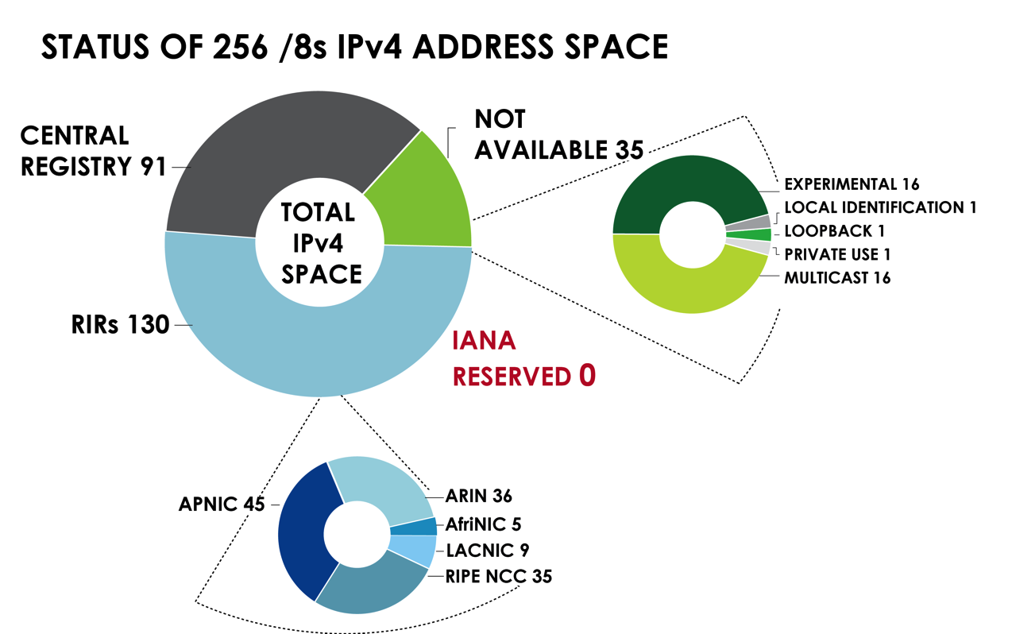
IPv4 ADDRESS SPACE
What is the status of each of the 256 /8s?

Slide 4
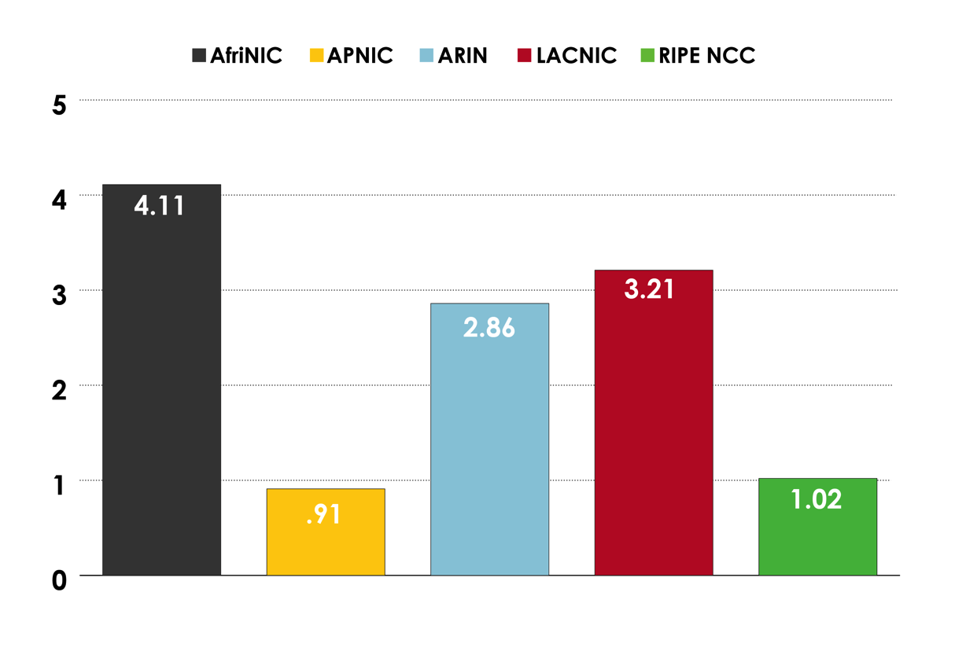
AVAILABLE IPv4 /8s IN EACH RIR

Slide 5
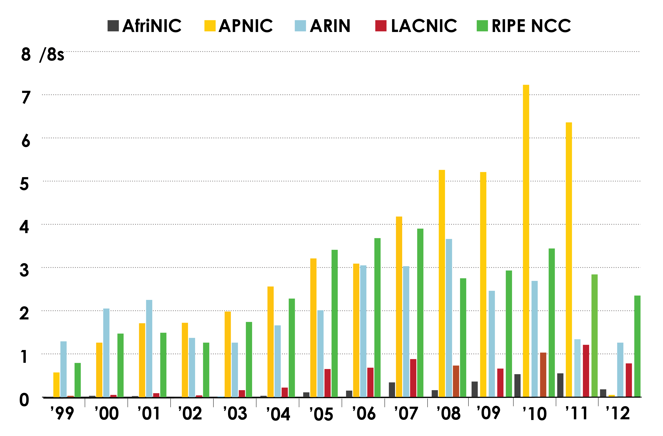
IPv4 ADDRESS SPACE ISSUED
(RIRs TO CUSTOMERS)
In terms of /8s, how much space did each RIR issue by year?

Slide 6
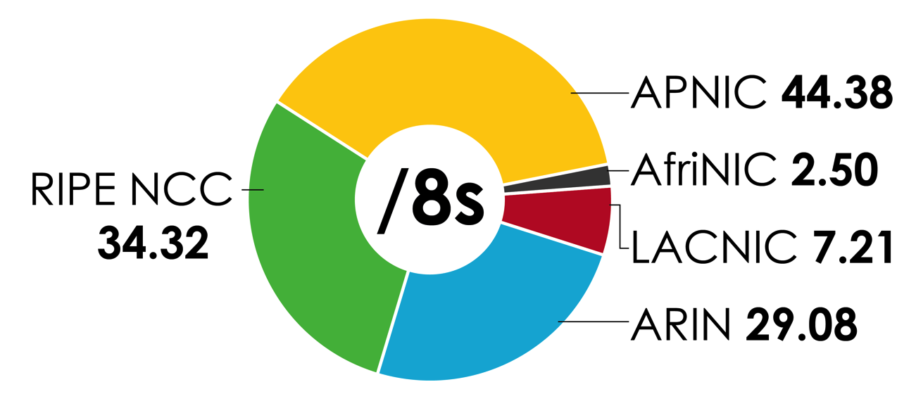
IPv4 ADDRESS SPACE ISSUED
(RIRs TO CUSTOMERS)
In terms of /8s, how much total space has each RIR issued?
(Jan 1999 – Sept 2012)

Slide 7
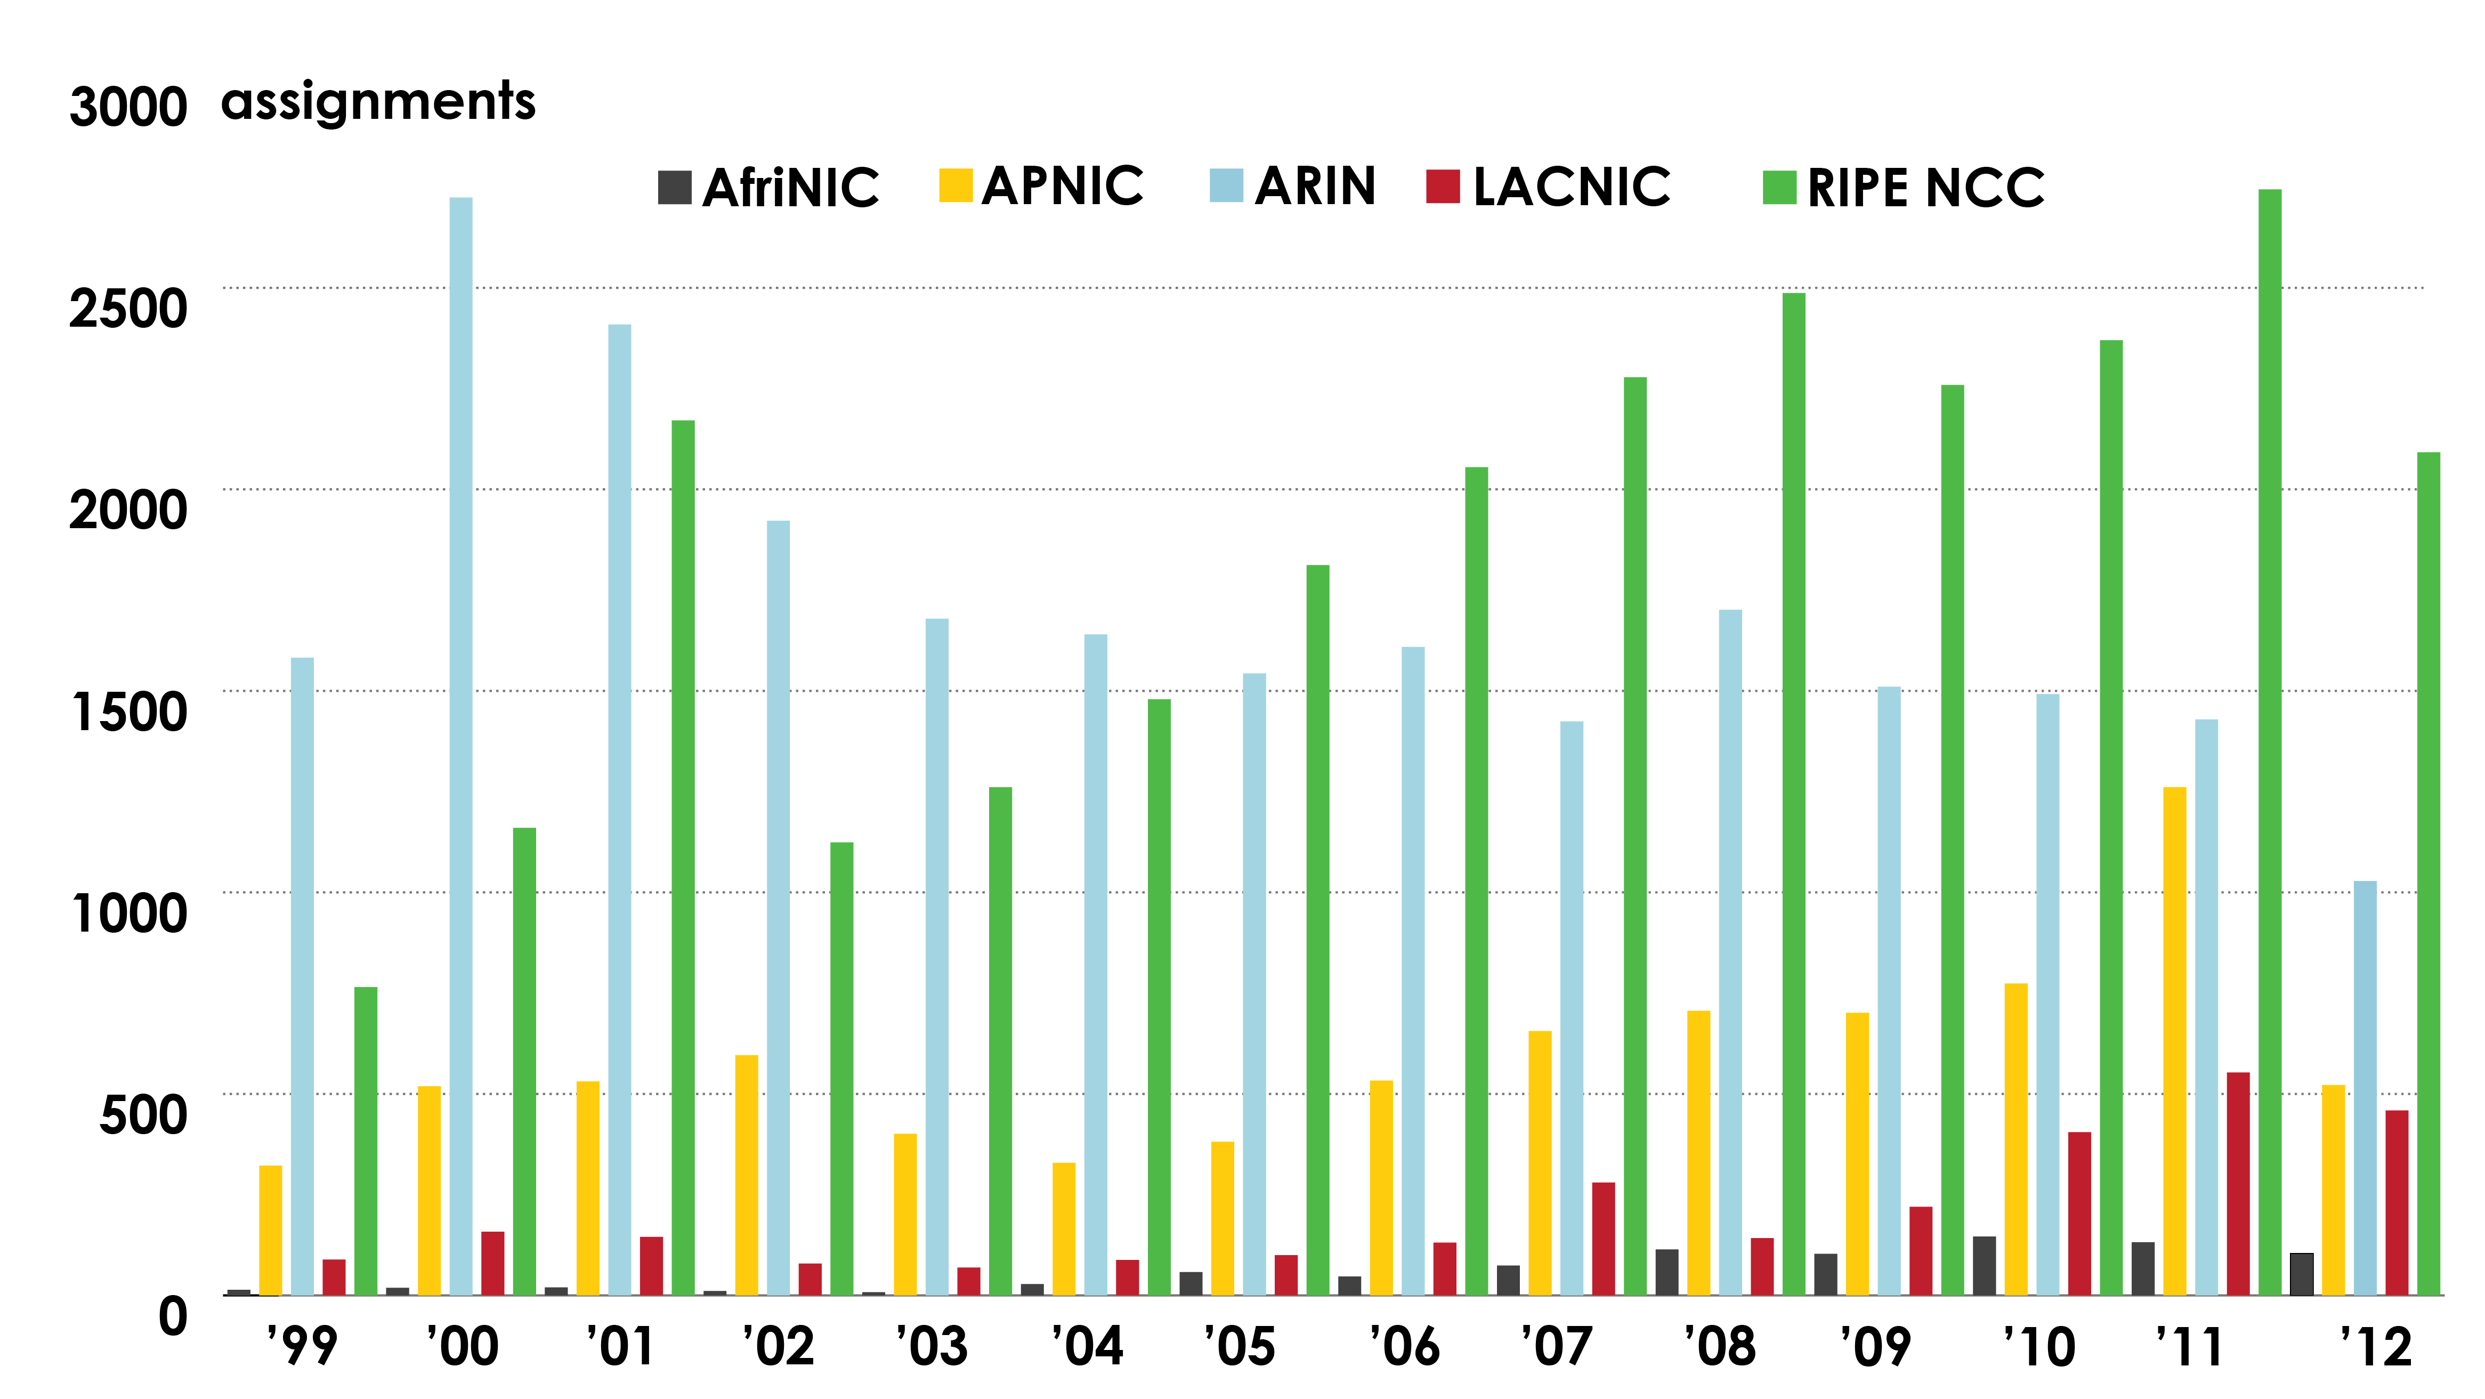
ASN ASSIGNMENTS (RIRs TO CUSTOMERS)
How many ASNs has each RIR assigned by year?

Slide 8
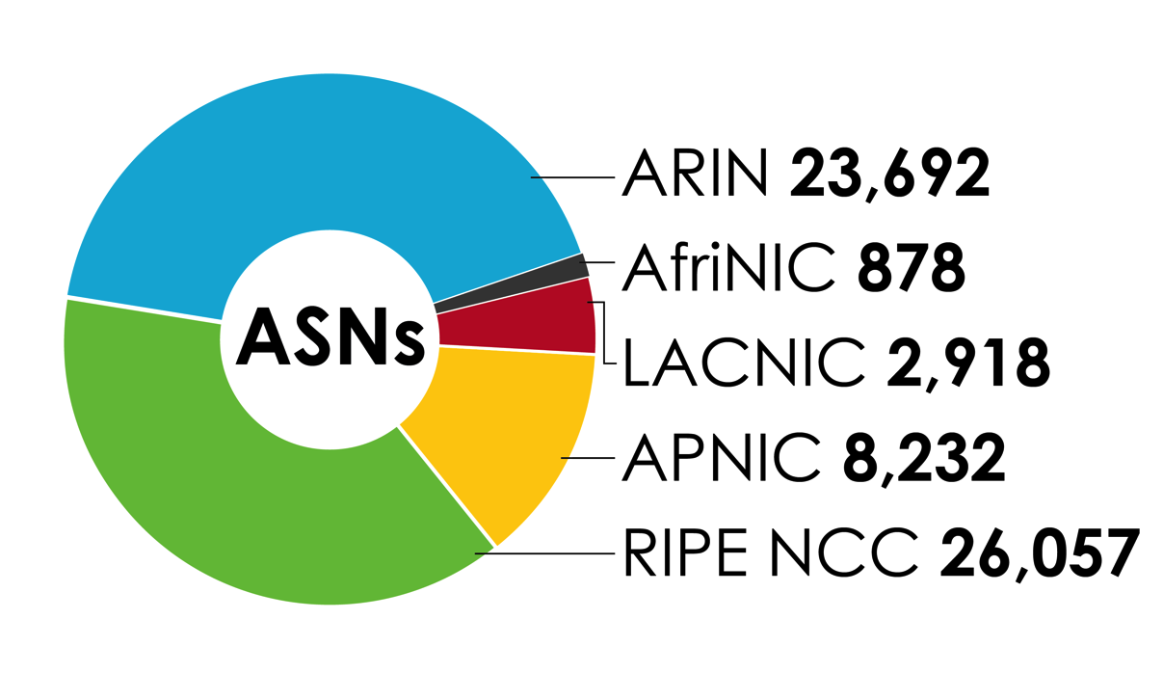
ASN ASSIGNMENTS (RIRs TO CUSTOMERS)
How many total ASNs has each RIR assigned?
(Jan 1999 – Sept 2012)

Slide 9
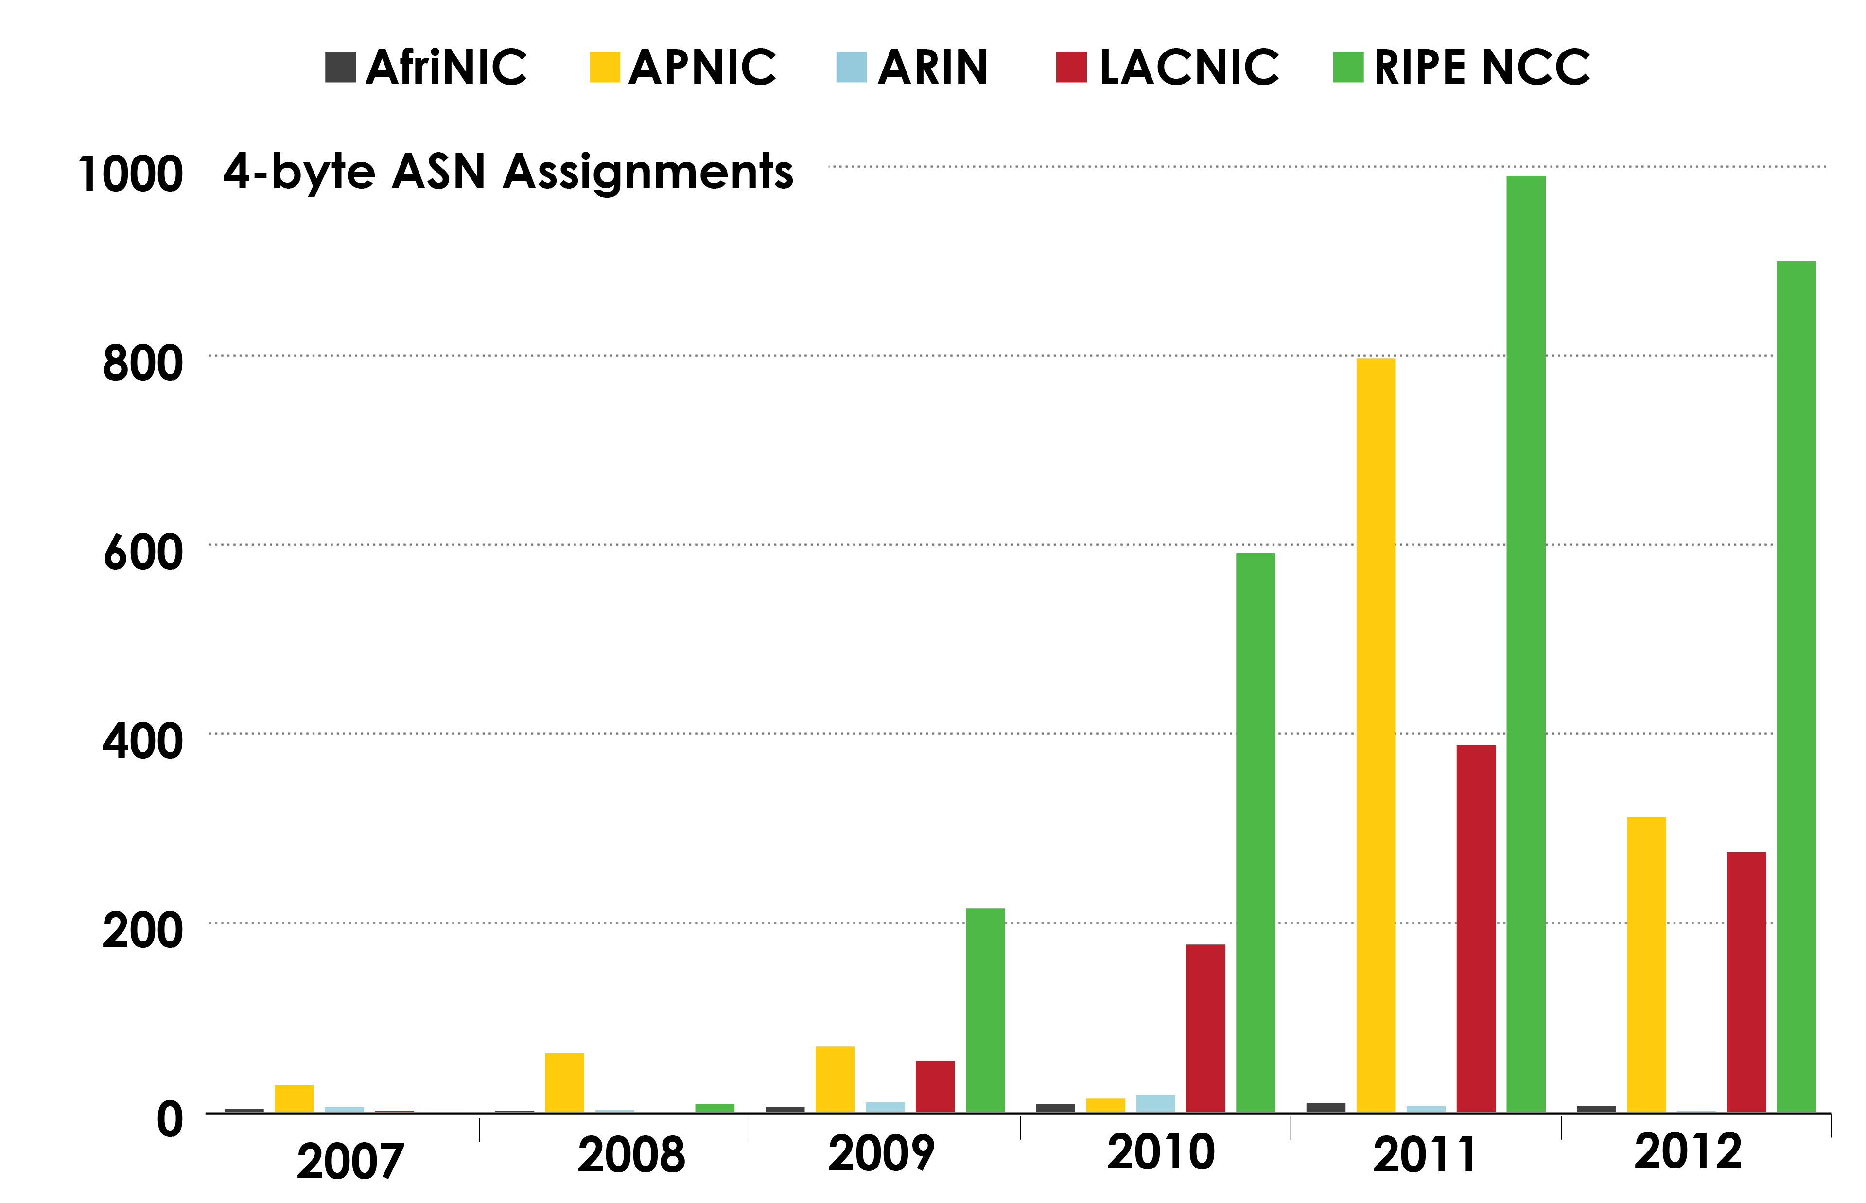
4-BYTE ASN ASSIGNMENTS
How many 4-byte ASNs has each RIR assigned by year?

Slide 10
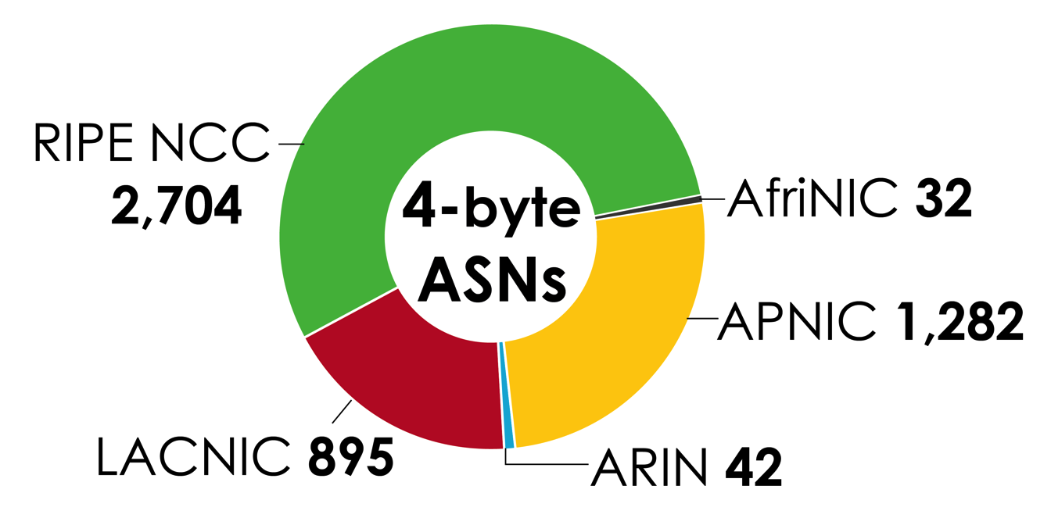
4-BYTE ASN ASSIGNMENTS
How many total 4-byte ASNs has each RIR assigned?
(Jan 2007 – Sept 2012)

Slide 11
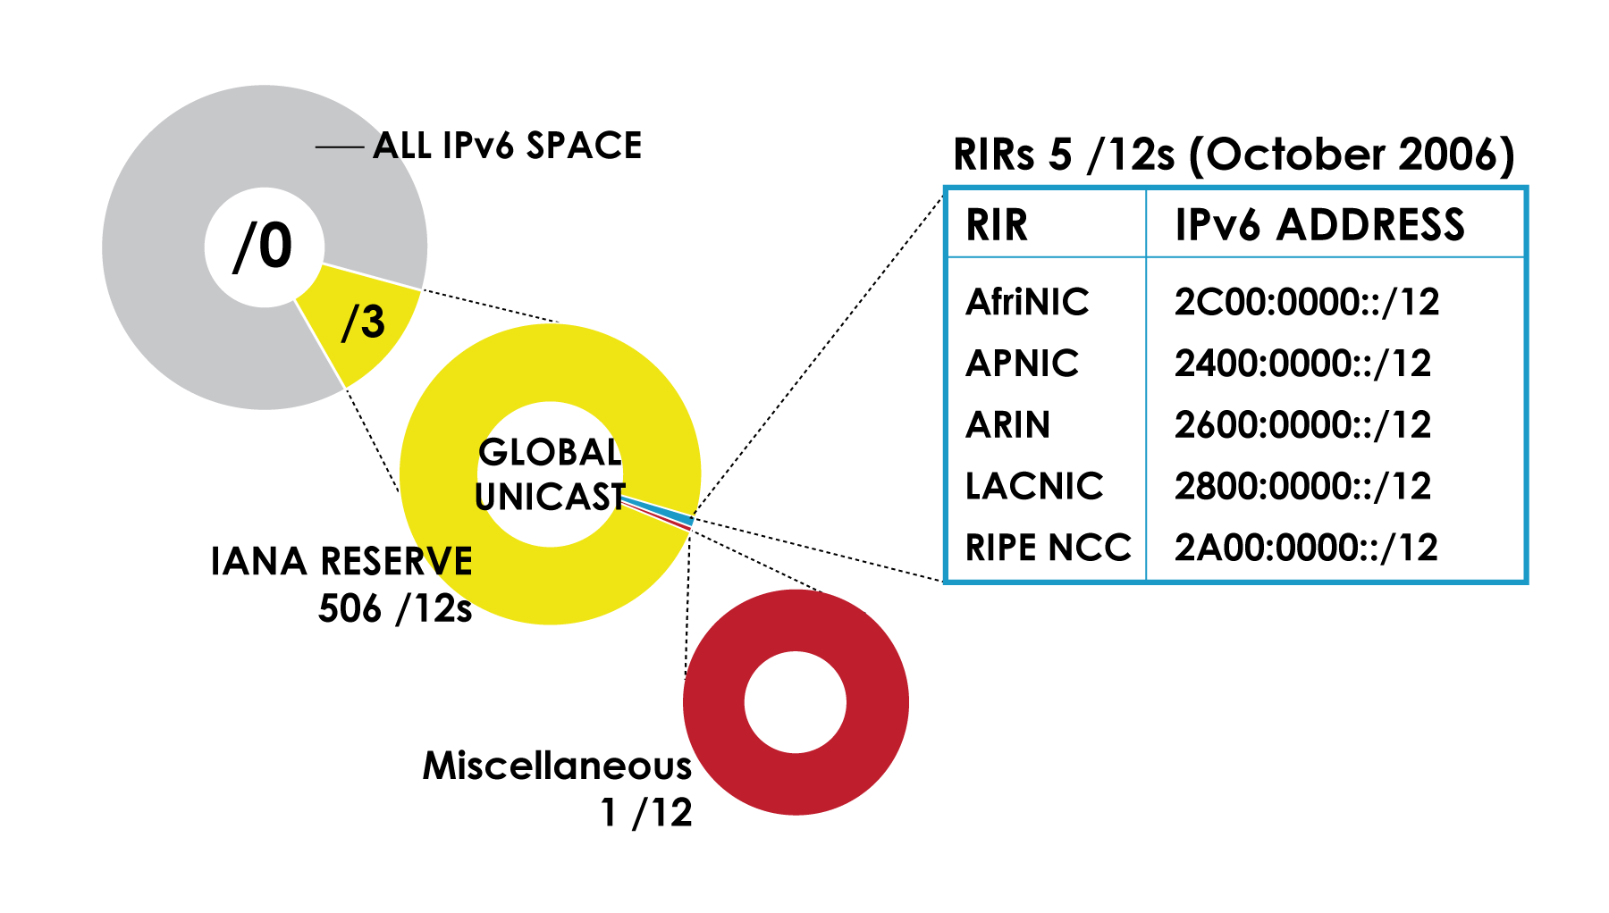
IPv6 ADDRESS SPACE
How much has been allocated to the RIRs?

Slide 12
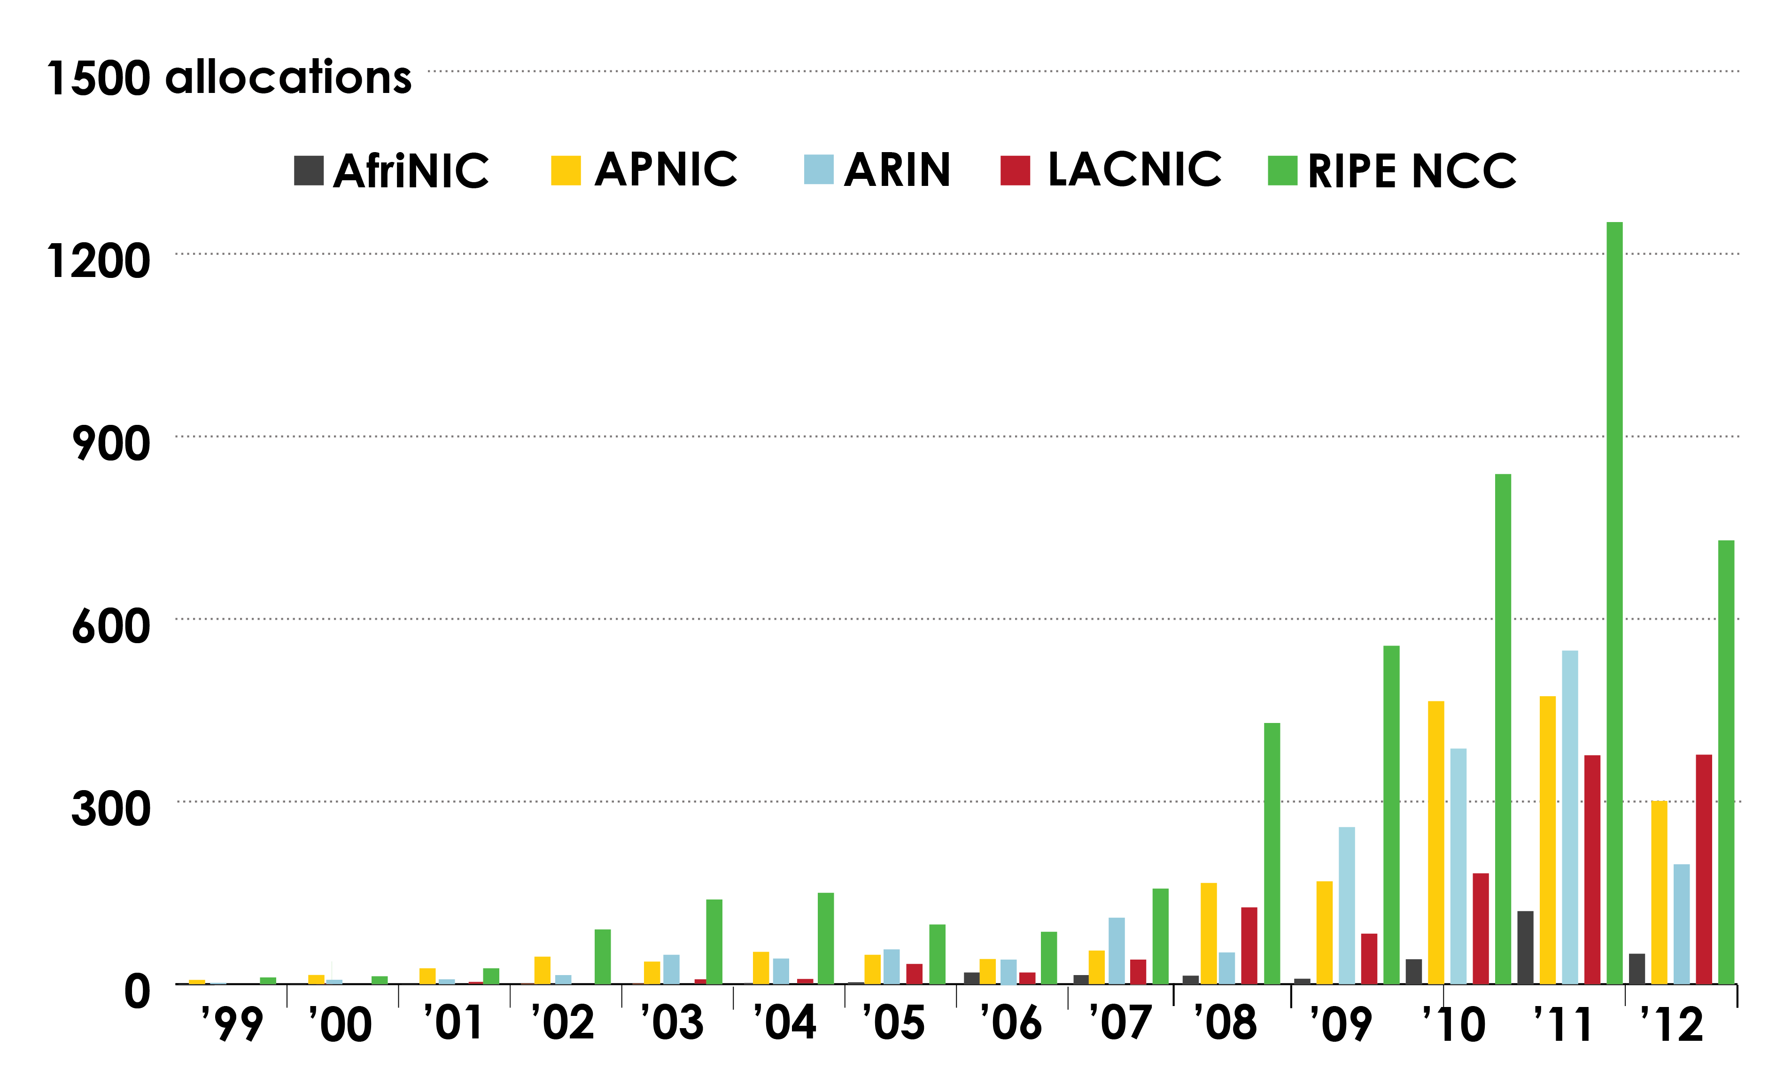
IPv6 ALLOCATIONS
(RIRs TO LIRs/ISPs)
How many allocations have been made by each RIR by year?

Slide 13
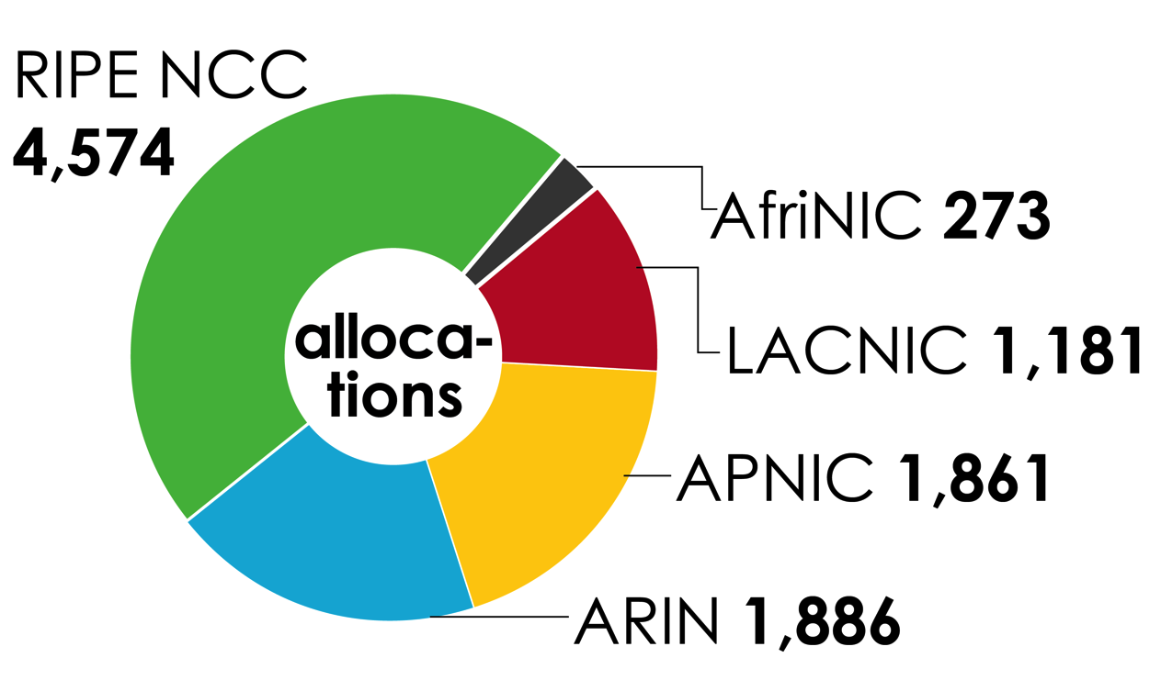
IPv6 ALLOCATIONS
(RIRs TO LIRs/ISPs)
How many total allocations have been made by each RIR? (Jan 1999 – Sept 2012)

Slide 14
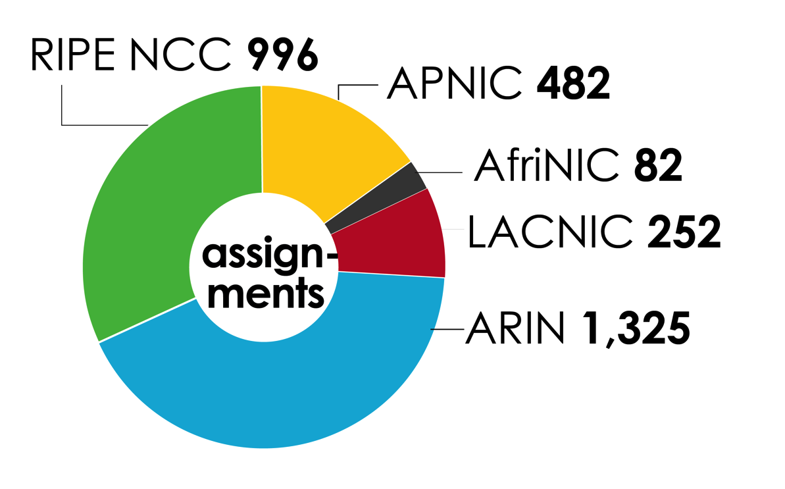
IPv6 ASSIGNMENTS
(RIRs TO LIRs/ISPs)
How many total assignments have been made by each RIR? (Jan 1999 – Sept 2012)

Slide 15
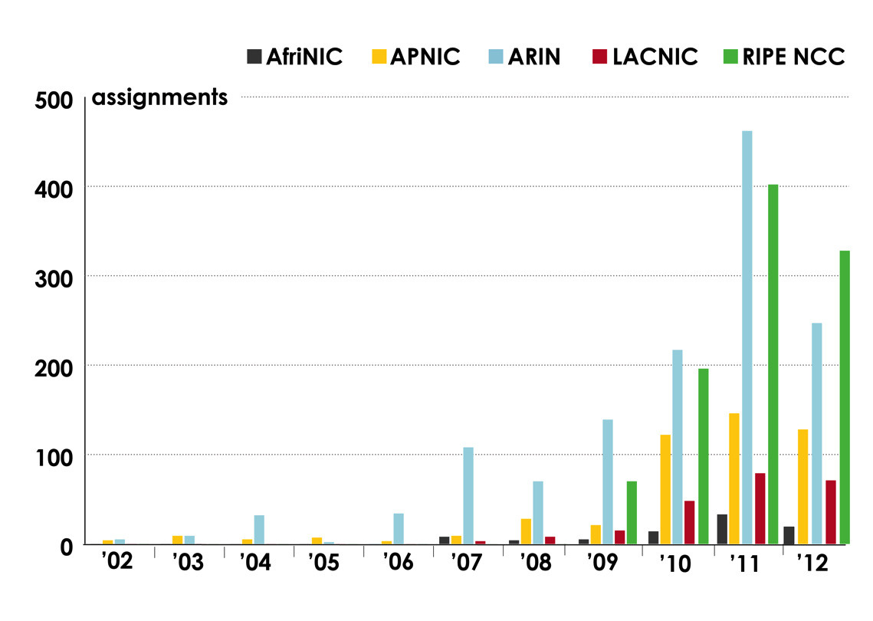
IPv6 ASSIGNMENTS RIRS TO END-USERS
How many assignments have been made by each RIR by year?

Slide 16
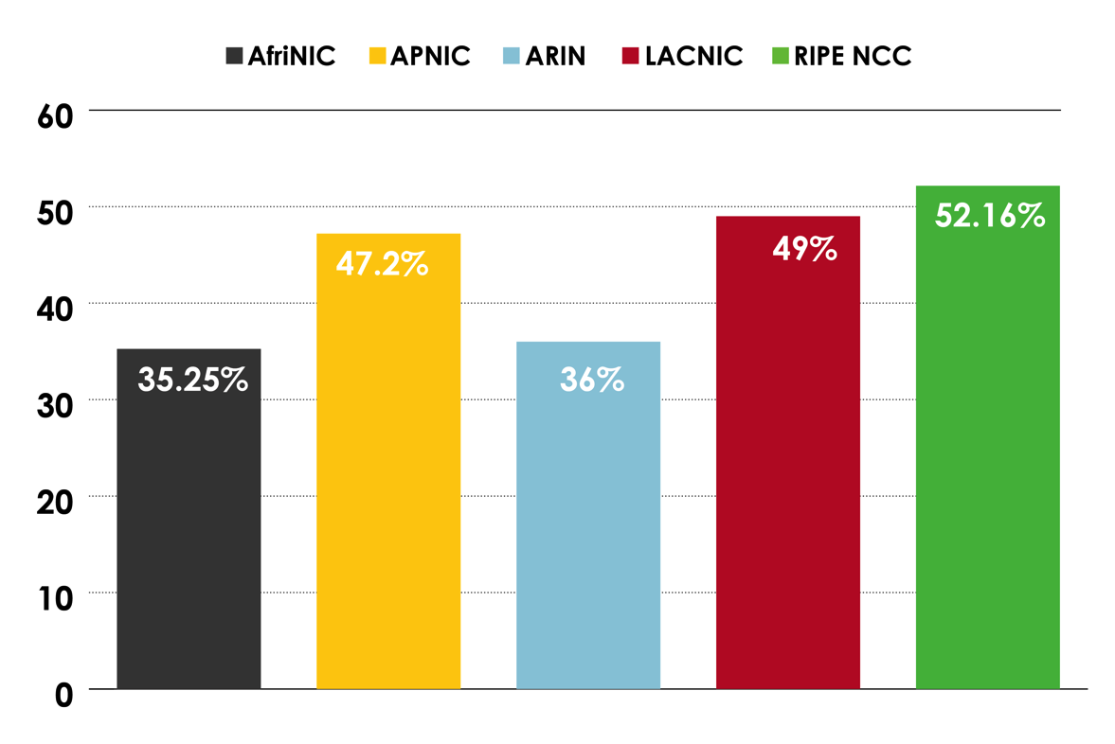
PERCENTAGE OF MEMBERS WITH BOTH IPv4 AND IPv6 IN EACH RIR

Slide 17
LINKS TO RIR STATISTICS
RIR Stats:
www.nro.net/statistics
Raw Data/Historical RIR Allocations:
www.iana.org/assignments/ipv4-address-space
www.iana.org/assignments/as-numbers
www.iana.org/assignments/ipv6-unicast-address-assignments

Slide 18
THANK YOU

