Slide 1


Slide 2
INTERNET NUMBER RESOURCE STATUS REPORT
As of 31 March 2015
Prepared by
Regional Internet Registries
AFRINIC, APNIC, ARIN, LACNIC and the RIPE NCC

Slide 3
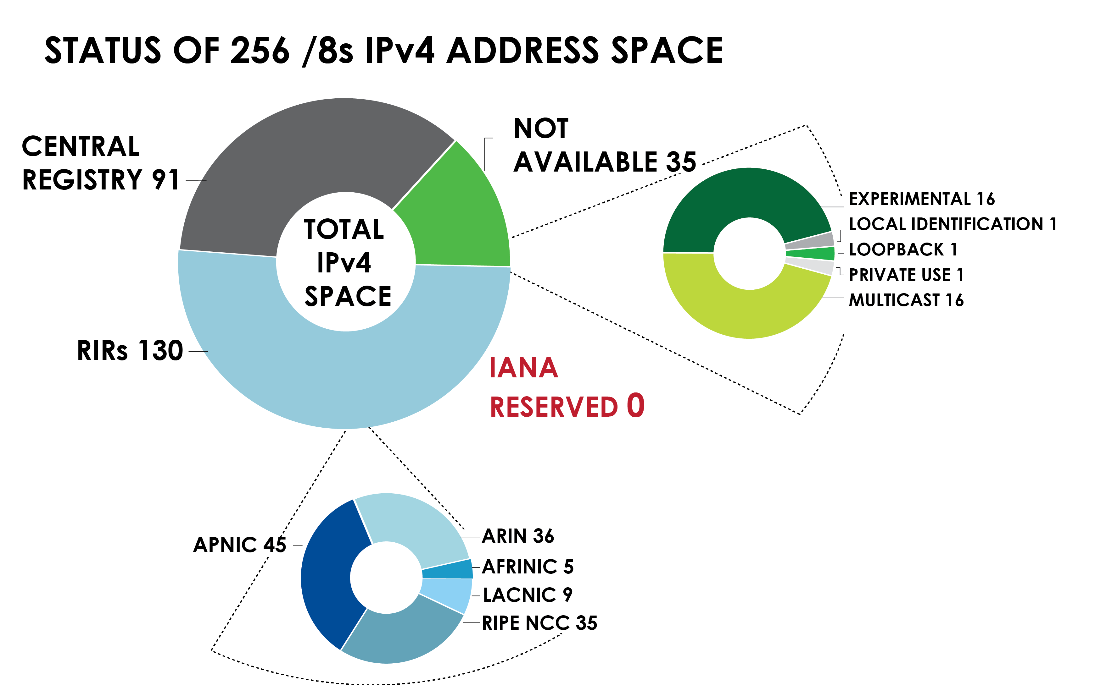
IPv4 ADDRESS SPACE
What is the status of each of the 256 /8s?

Slide 4
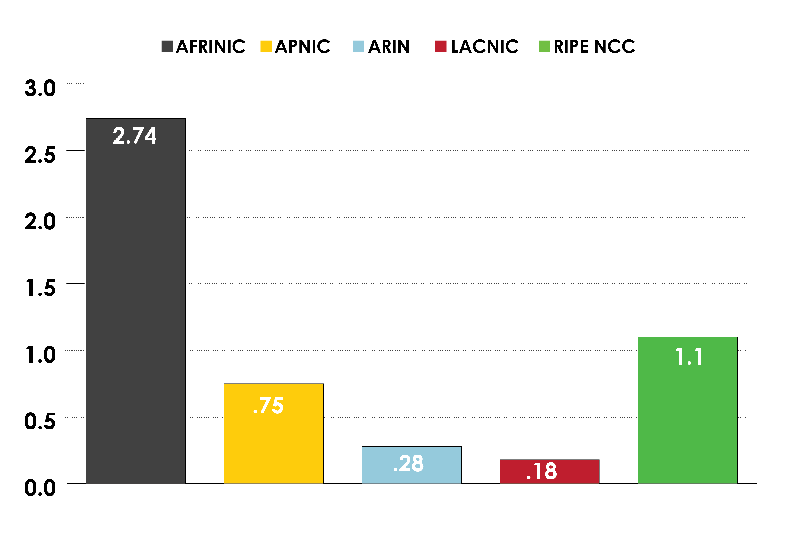
AVAILABLE IPv4 /8s IN EACH RIR

Slide 5
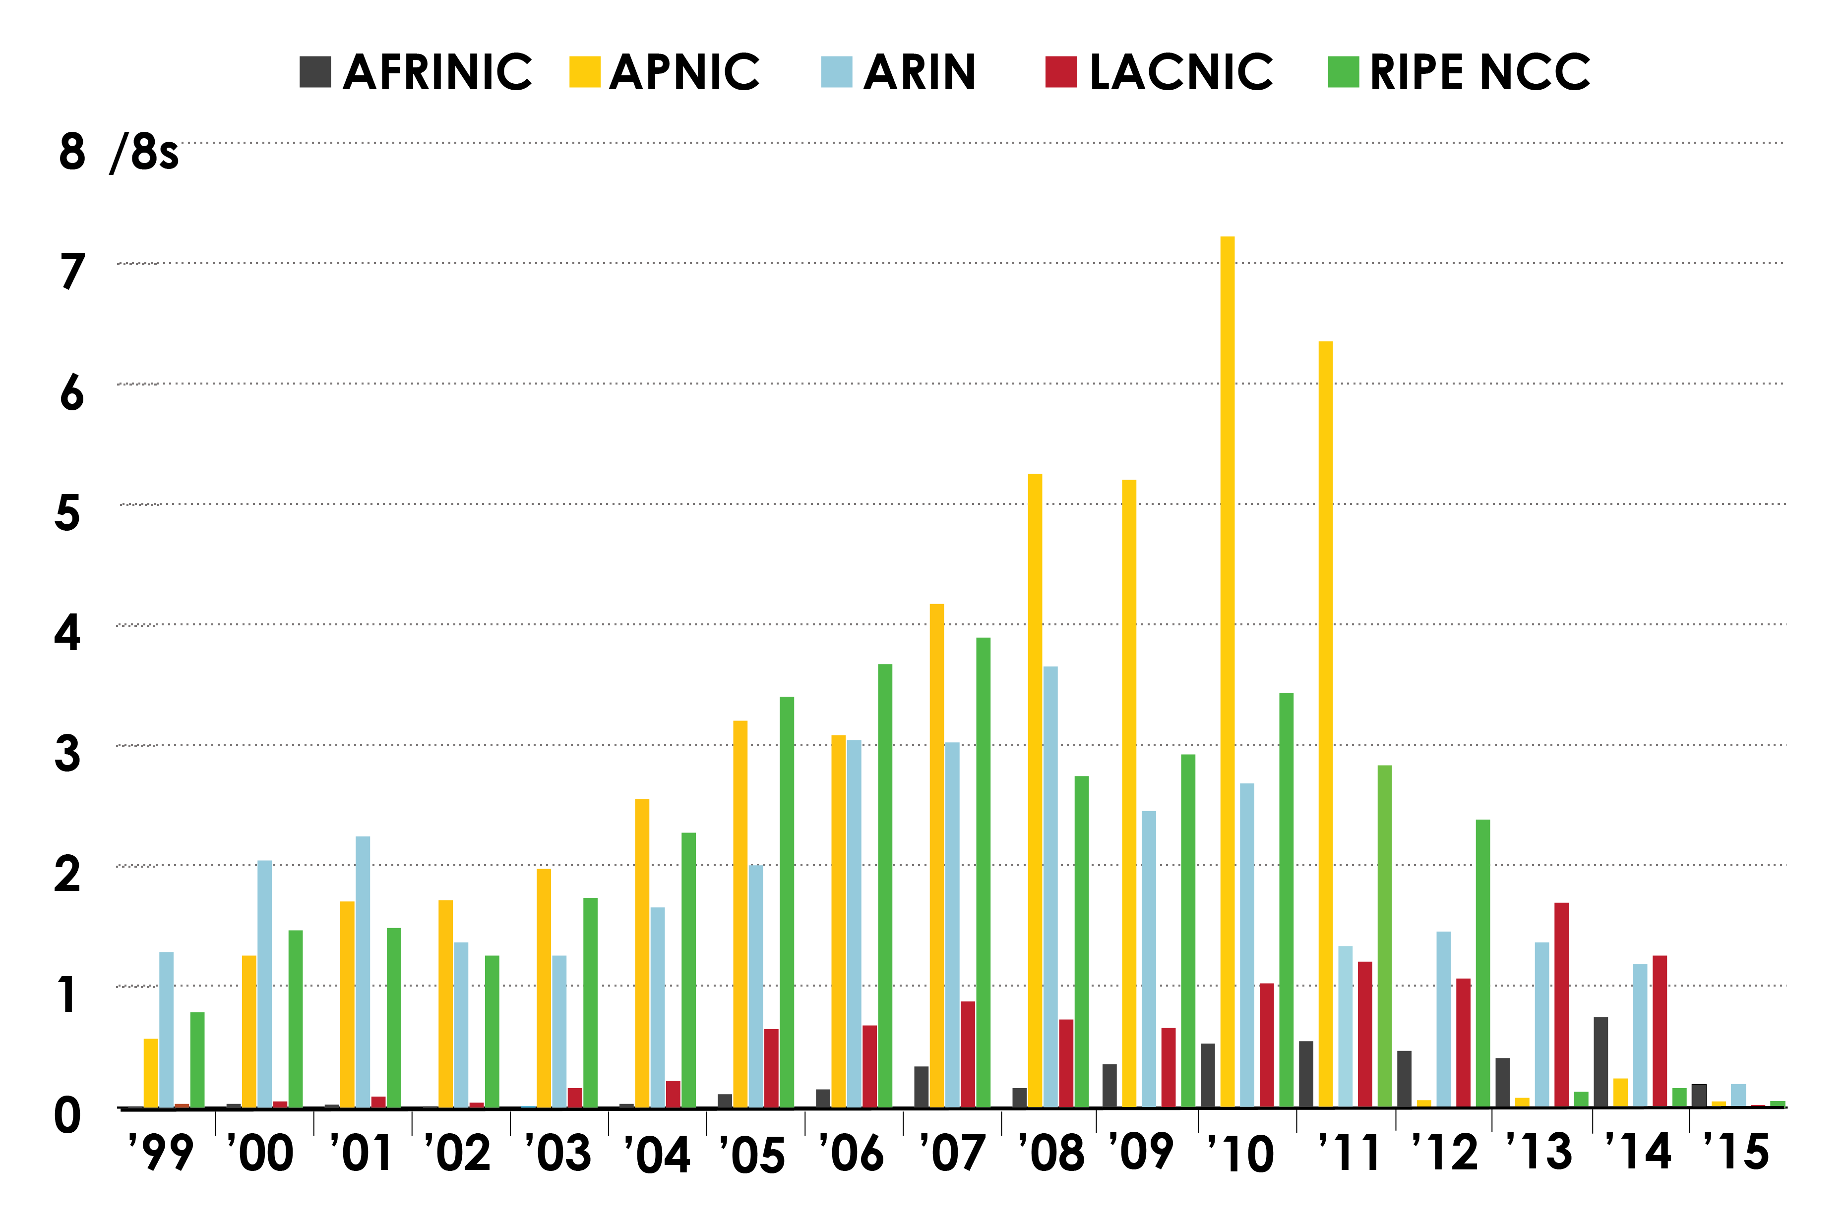
IPv4 ADDRESS SPACE ISSUED
(RIRs TO CUSTOMERS)
In terms of /8s, how much space did each RIR issue by year?

Slide 6
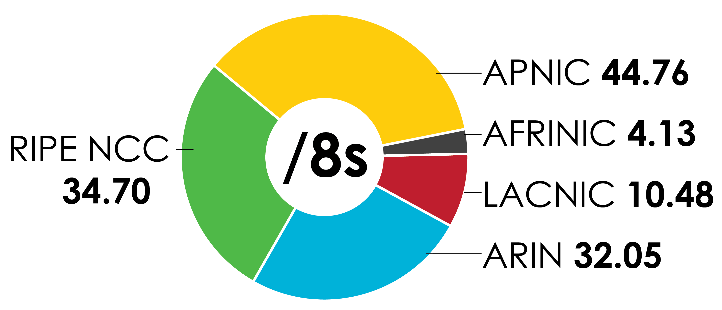
IPv4 ADDRESS SPACE ISSUED
(RIRs TO CUSTOMERS)
In terms of /8s, how much total space has each RIR issued?
(Jan 1999 – Mar 2015)

Slide 7
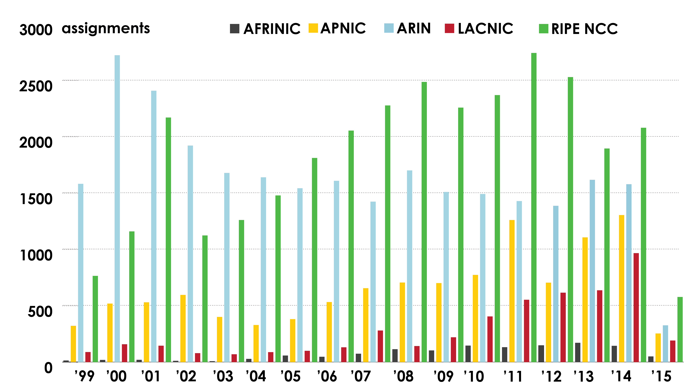
ASN ASSIGNMENTS (RIRs TO CUSTOMERS)
How many ASNs has each RIR assigned by year?

Slide 8
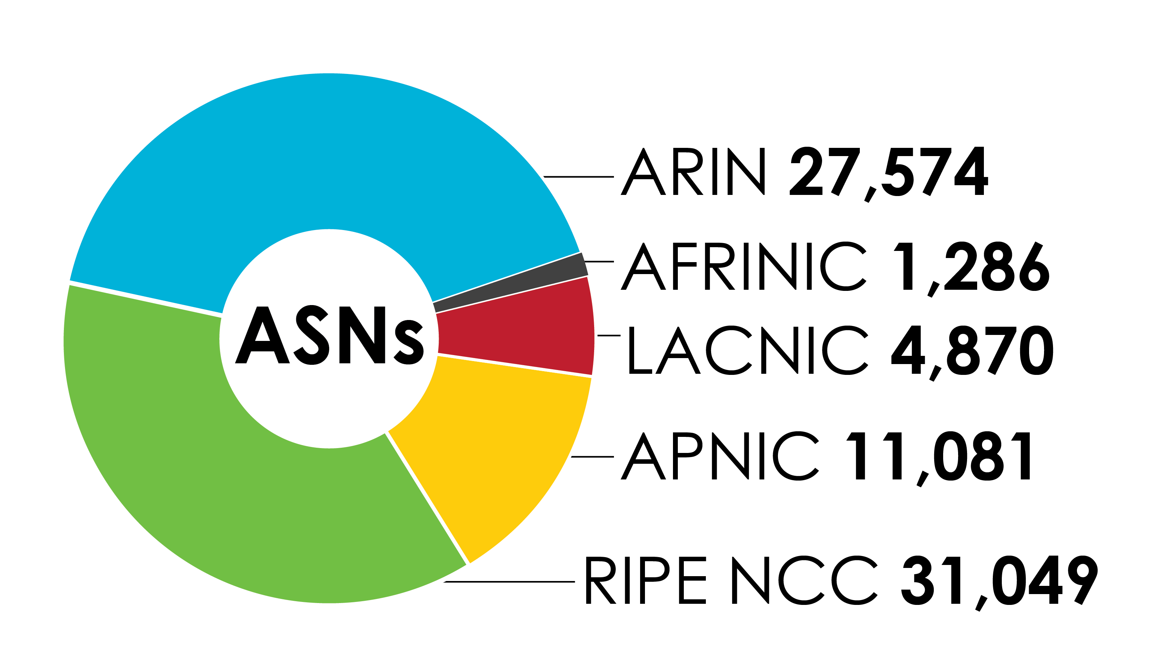
ASN ASSIGNMENTS (RIRs TO CUSTOMERS)
How many total ASNs has each RIR assigned?
(Jan 1999 – Mar 2015)

Slide 9
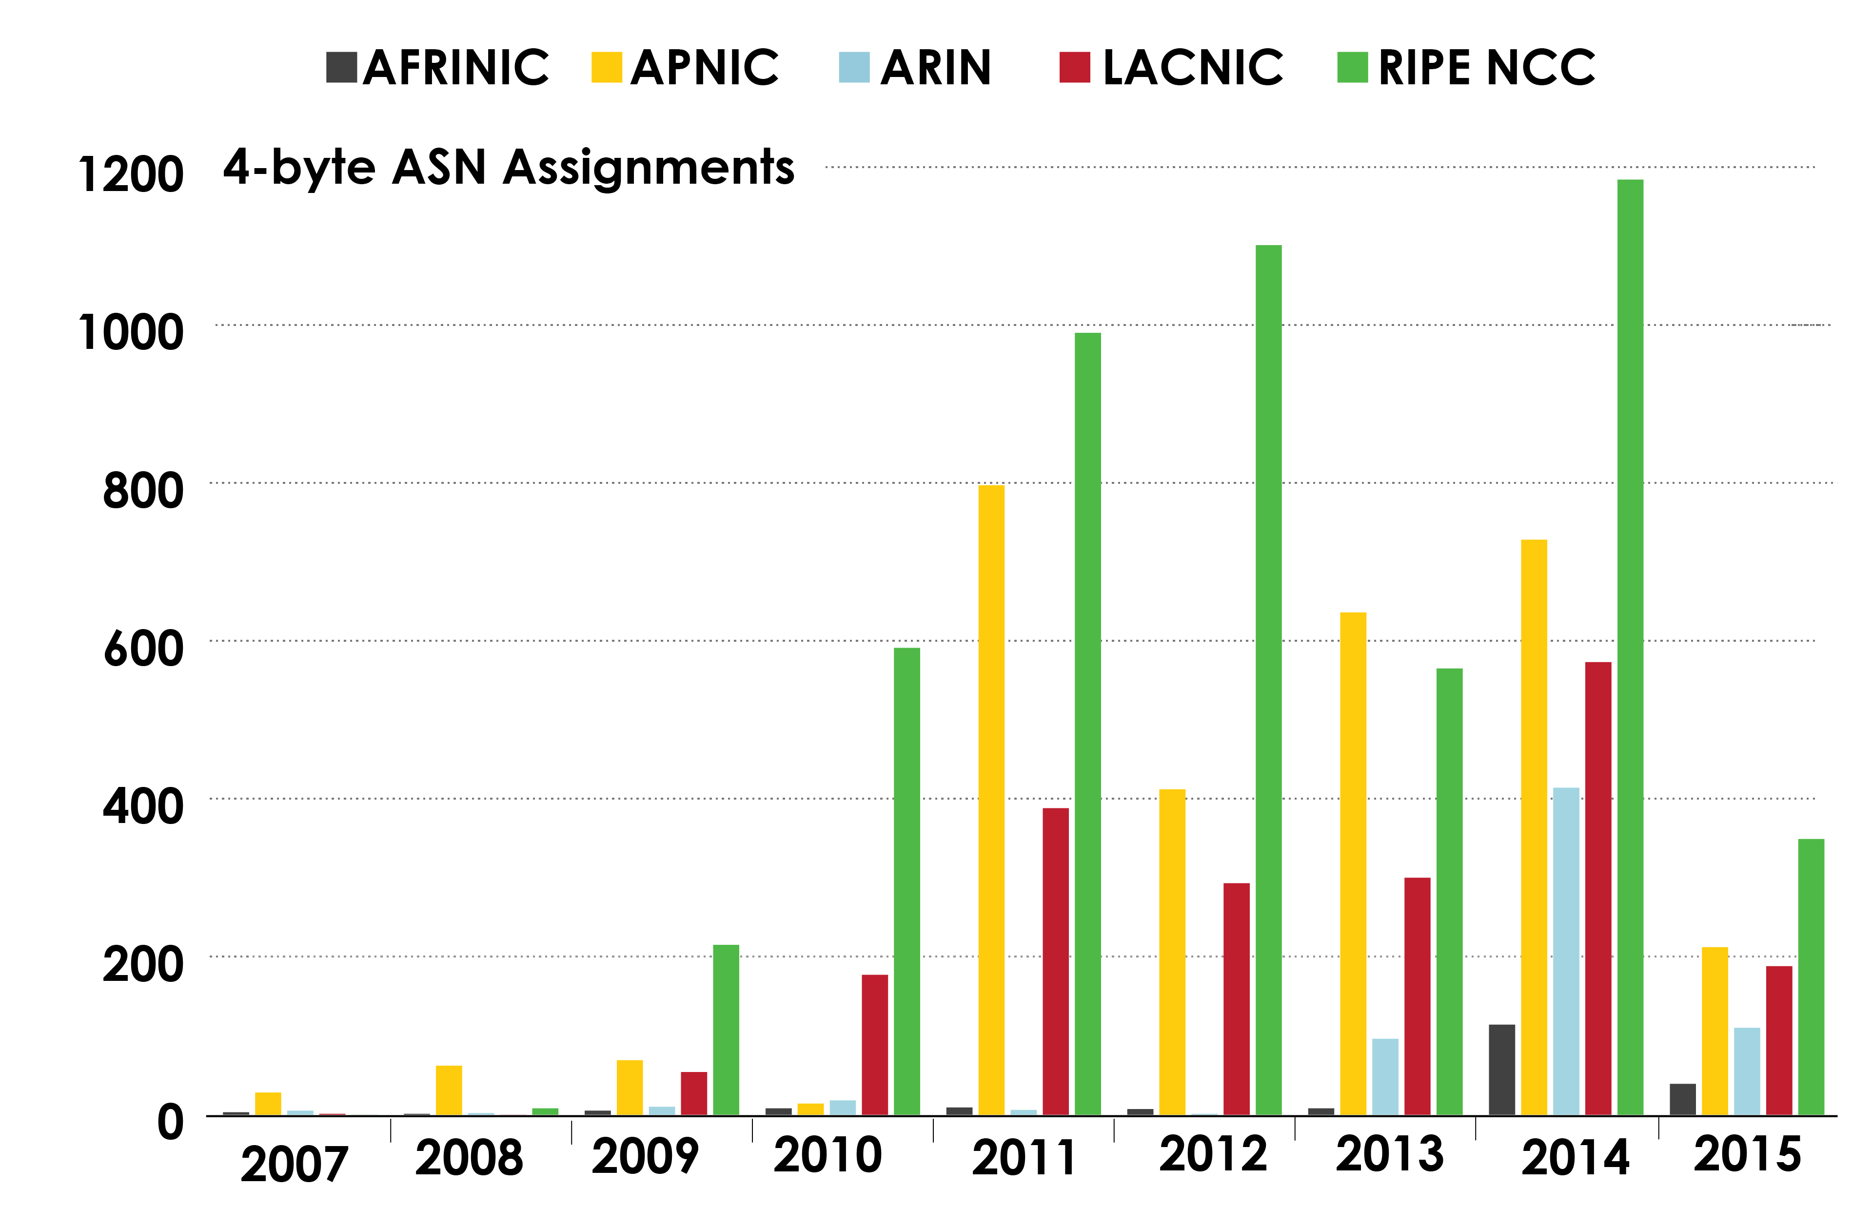
4-BYTE ASN ASSIGNMENTS
How many 4-byte ASNs has each RIR assigned by year?

Slide 10
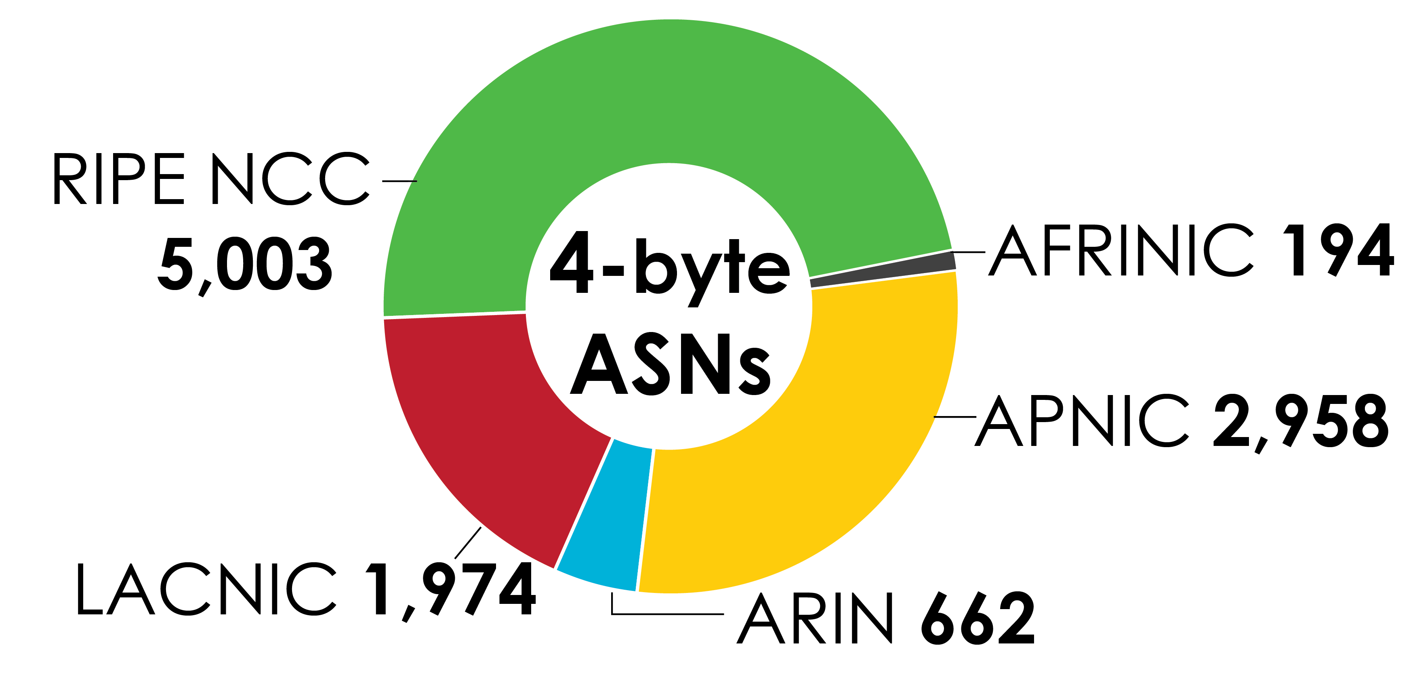
4-BYTE ASN ASSIGNMENTS
How many total 4-byte ASNs has each RIR assigned?
(Jan 2007 – March 2015)

Slide 11
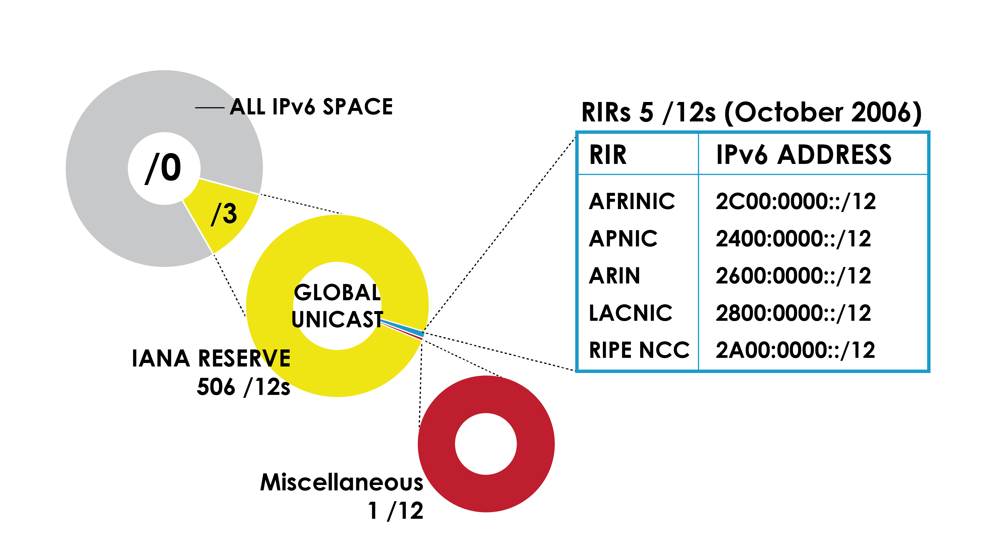
IPv6 ADDRESS SPACE
How much has been allocated to the RIRs?

Slide 12
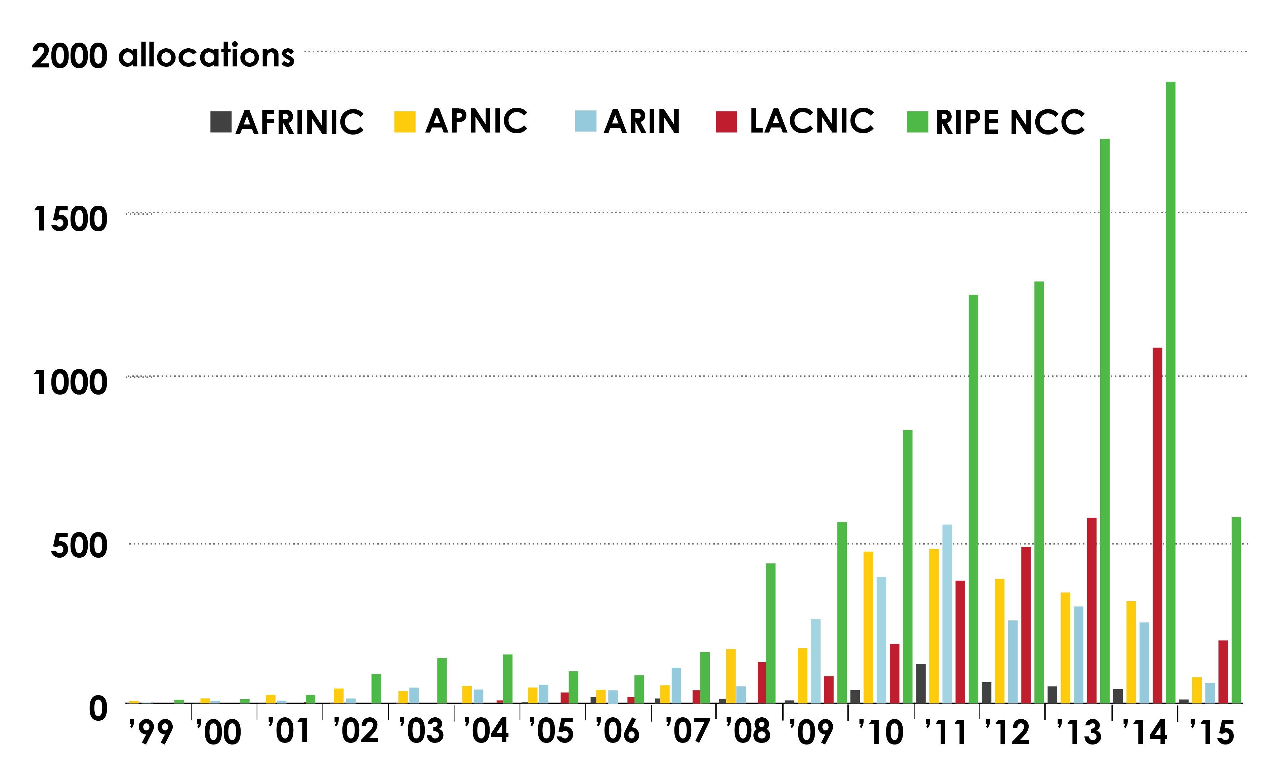
IPv6 ALLOCATIONS
(RIRs TO LIRs/ISPs)
How many allocations have been made by each RIR by year?

Slide 13
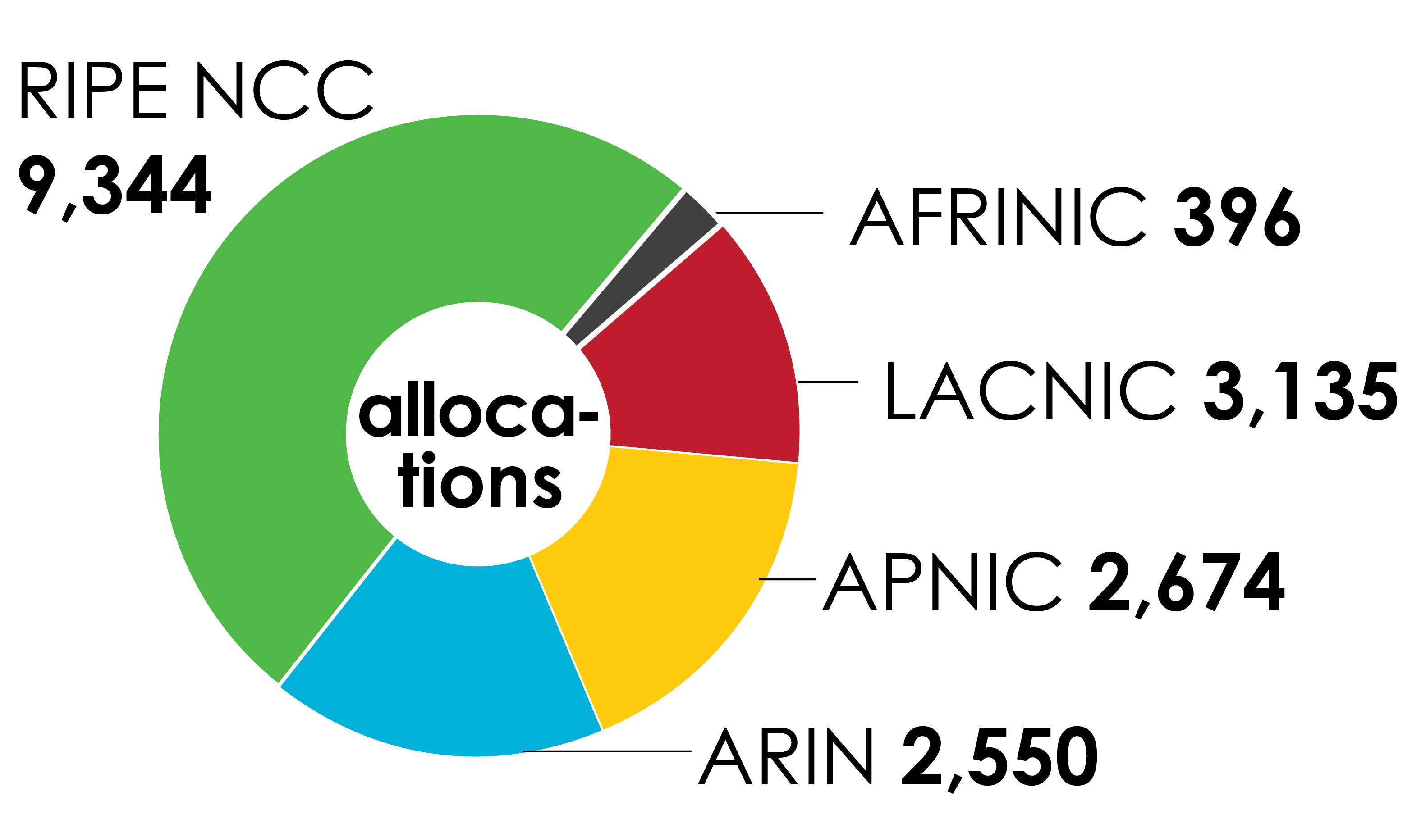
IPv6 ALLOCATIONS
(RIRs TO LIRs/ISPs)
How many total allocations have been made by each RIR? (Jan 1999 – Mar 2015)

Slide 14
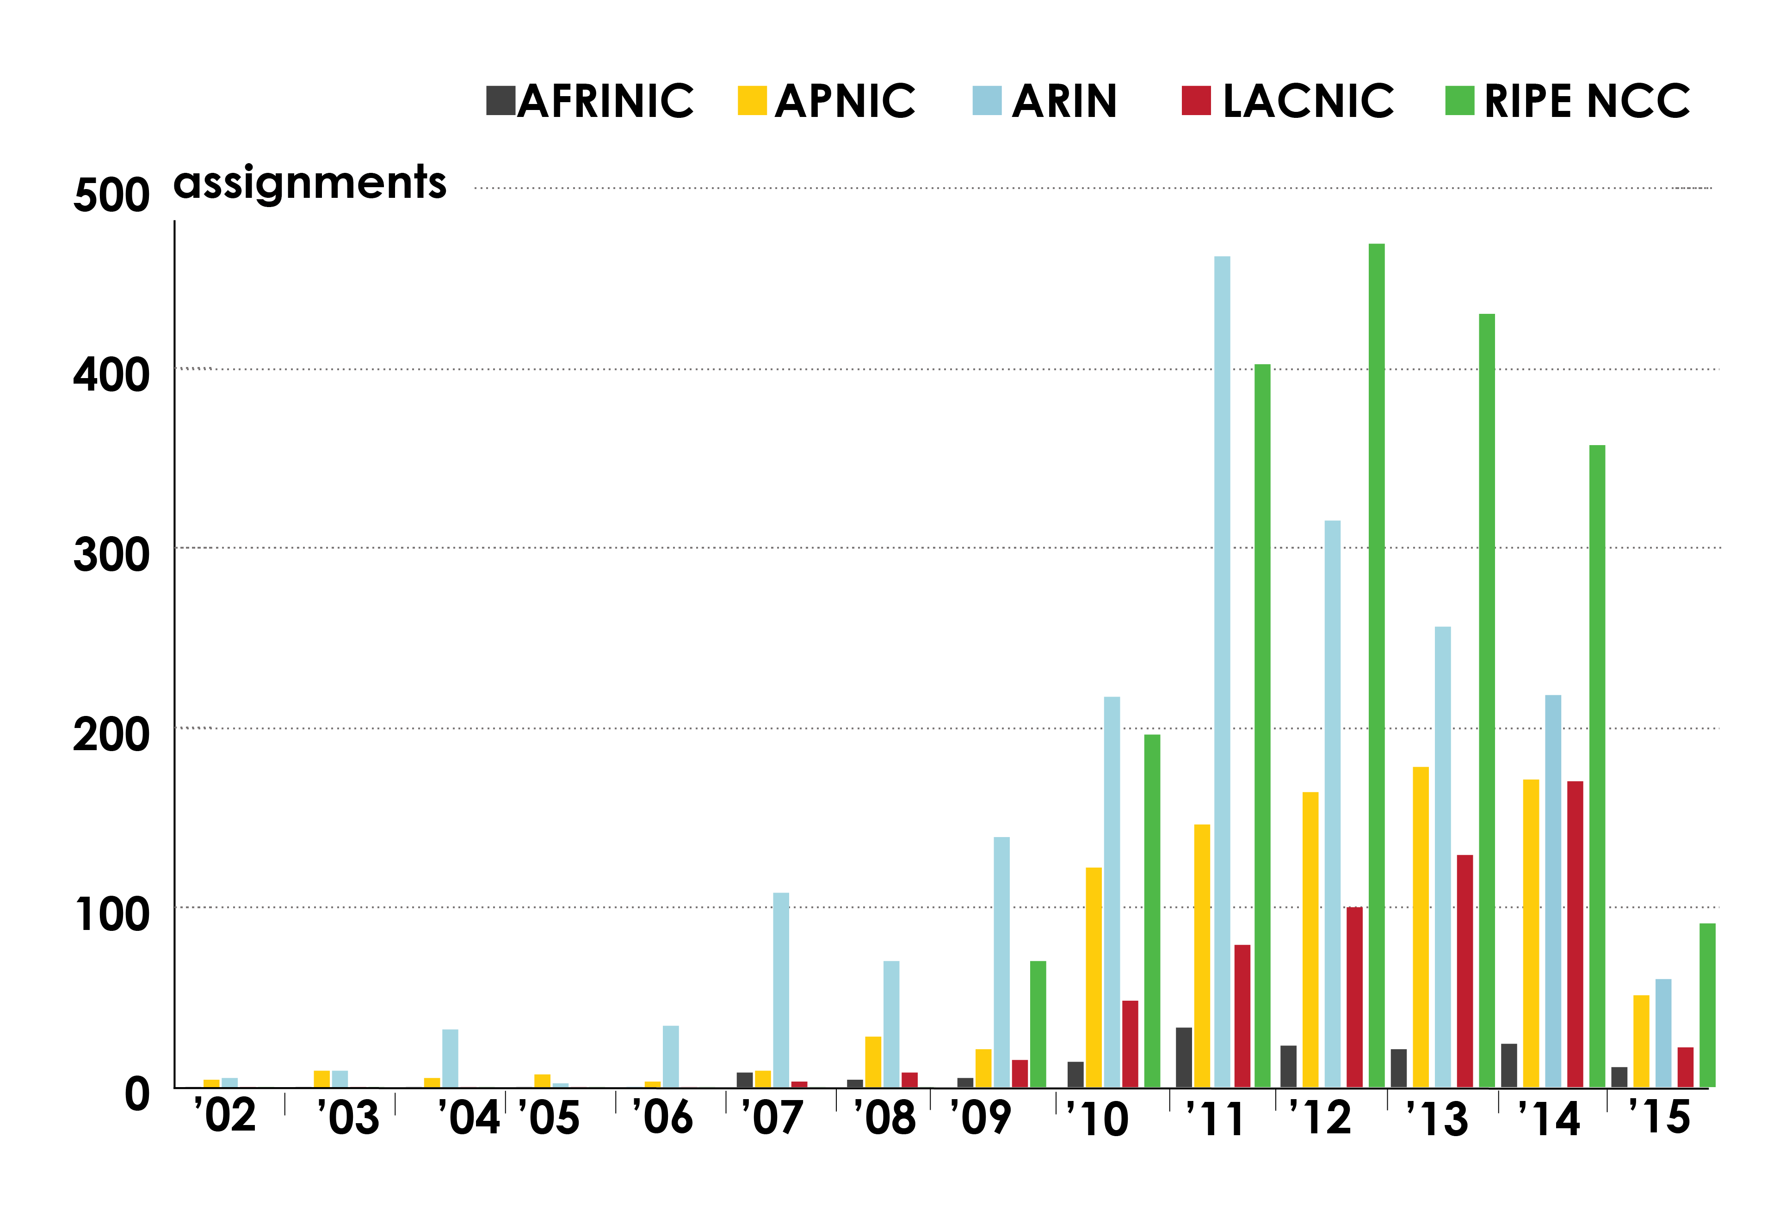
IPv6 ASSIGNMENTS RIRS TO END-USERS
How many assignments have been made by each RIR by year?

Slide 15
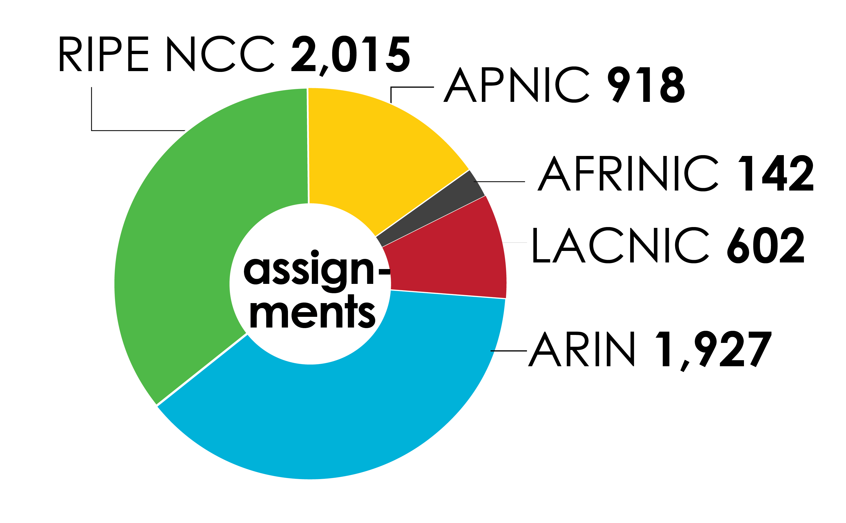
IPv6 ASSIGNMENTS
(RIRs TO END-USERS)
How many total assignments have been made by each RIR? (Jan 2002 – Mar 2015)

Slide 16
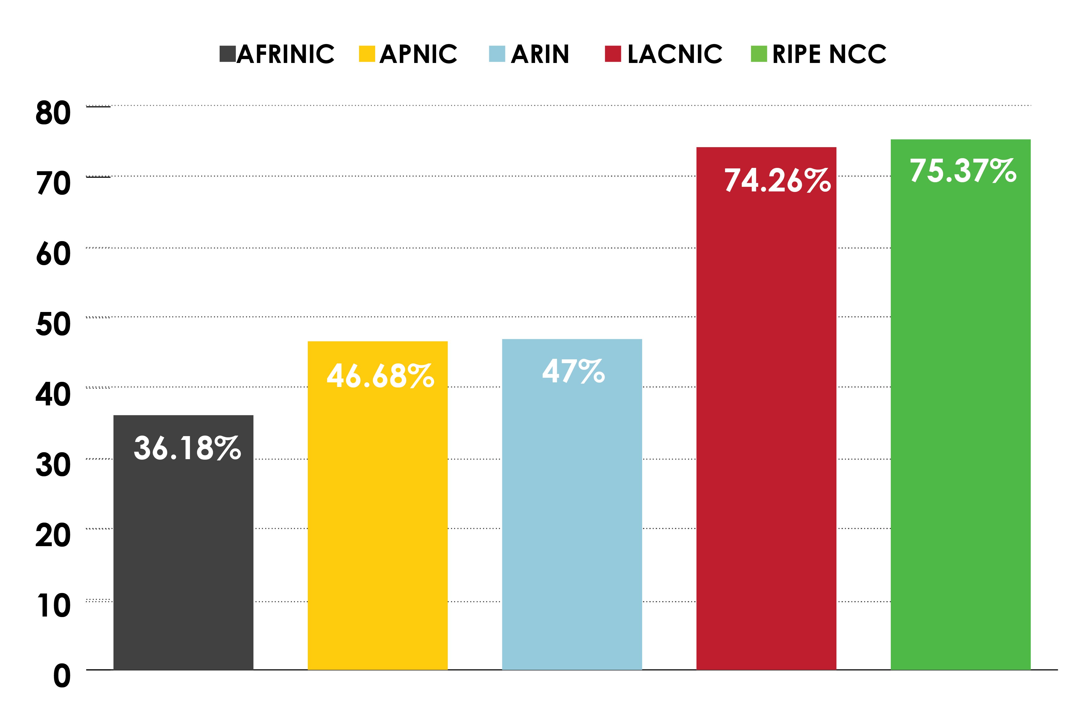
PERCENTAGE OF MEMBERS WITH BOTH IPv4 AND IPv6 IN EACH RIR

Slide 17
LINKS TO RIR STATISTICS
RIR Stats:
www.nro.net/statistics
Raw Data/Historical RIR Allocations:
www.iana.org/assignments/ipv4-address-space
www.iana.org/assignments/as-numbers
www.iana.org/assignments/ipv6-unicast-address-assignments

Slide 18
THANK YOU

