Slide 1
Board Update
ICANN 84 | 29 October 2025

Slide 2
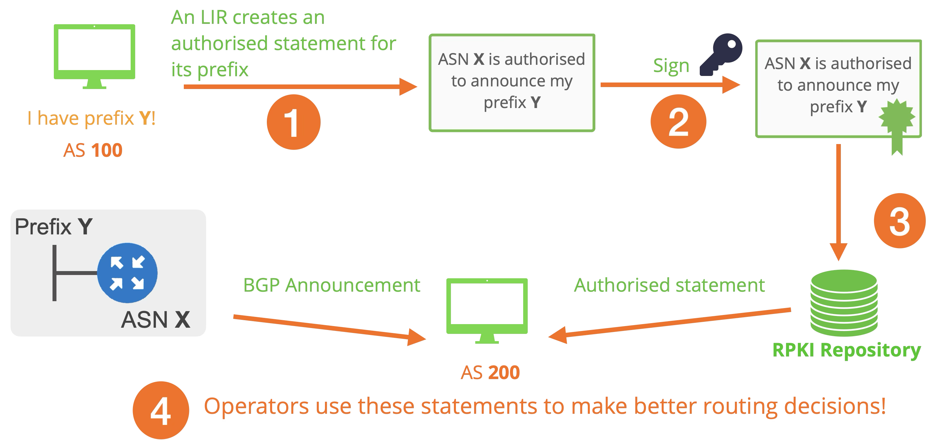
What is RPKI?

Slide 3
The NRO RPKI Program
To provide a more consistent and uniformly secure, resilient and reliable RPKI service
To remove barriers for RPKI adoption currently experienced by network operators who create RPKI objects through multiple RIRs
To improve routing security through the further development of protocols with the technical community

Slide 4
RPKI NRO Program Objectives
Progress towards improved transparency, robustness, and security of the RPKI system
Key aspects of robustness documented
TA configuration problem statement and potential solutions
Increased consistency of the RPKI system user experience
Documentation of baseline for RPKI services/features offered by each RIR
User research with users interacting with multiple RIRs
The technical community is kept informed and engaged throughout the program.
RPKI Program updates presented at relevant events
Articles published on RIR blogs

Slide 5
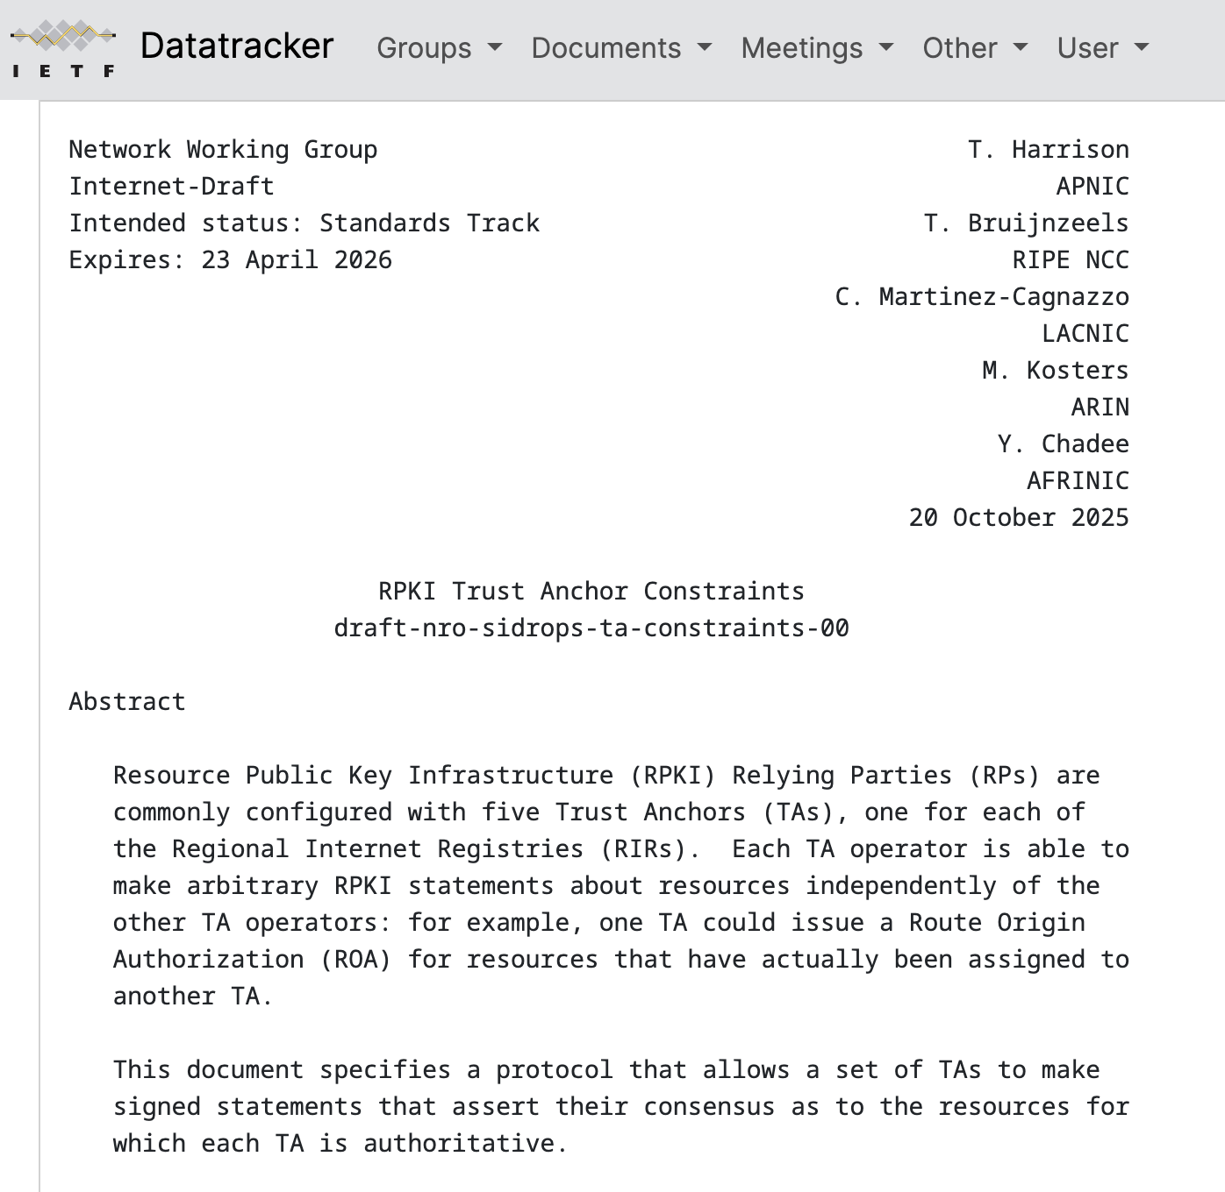
RPKI: IETF Proposal
Proposal under discussion with the IETF
Trust Anchor problem statement and potential solutions – being discussed and developed with community involvement.
Notes:
Although there is probably multiple areas that would benefit from better coordination and collaboration among the five RIRs in the RPKI space, there are a couple of challenges that we are aware of that make the RPKI Program particularly important. We know that there is some diversity and inconsistency in the way the five RPKI systems have been implemented, and the features and related services offered and how they are made available. This is pictured for example by the annex in the MANRS document on requirements and standards for operators of RPKI services, where it’s shown that not all the RIRs comply with all those requirements and standards. (The table is out of date. The SG we will be providing MANRS with an updated version)
We know that there is some diversity and inconsistency in the way the five RPKI systems have been implemented, and the features and related services offered and how they are made available.

Slide 6
ASPA: Autonomous System Provider Authorisations
Why is it important?
  Improves Internet routing security at the Autonomous System Numbers (ASN) level
  Protects your network against leaks and easy path spoofing
  Helps other networks – greater deployment improves validation for everyone
Notes:
Although there is probably multiple areas that would benefit from better coordination and collaboration among the five RIRs in the RPKI space, there are a couple of challenges that we are aware of that make the RPKI Program particularly important. We know that there is some diversity and inconsistency in the way the five RPKI systems have been implemented, and the features and related services offered and how they are made available. This is pictured for example by the annex in the MANRS document on requirements and standards for operators of RPKI services, where it’s shown that not all the RIRs comply with all those requirements and standards. (The table is out of date. The SG we will be providing MANRS with an updated version)
We know that there is some diversity and inconsistency in the way the five RPKI systems have been implemented, and the features and related services offered and how they are made available.

Slide 7
ASPA Object Structure (simplified)
EE Certificate
Public Key
AS Number
Signed by CA Private Key
Not Before
Not After
eContent
Customer AS Number
Provider AS Numbers
Signature
SHA256 Hash
Signed by EE Private Key
RPKI Signed Object Template (RFC 6488)
Intermediate End-Entity (EE) Certificate
  Customer AS used in content
  MUST be included in CA certificate
  Signed by CA certificate private key
eContent
  Specific format for ASPA
  One Customer AS (held by signer)
  One or more Provider AS
The holder of the Customer AS Number declares which AS Numbers may appear as their Providers in BGP paths

Slide 8
ASPA Verification - Routes from Customers
Spoofed origin AS
Given:
192.168.0.0/24 => AS4
AS3 => [ AS1 ]
AS4 => [ AS2 ]
AS1 sees 1 3 5 4 192.168.0.0/24
AS1 knows:
AS3 is a customer session
AS5 is “Not Provider” for AS4
Therefore, this is invalid.
AS1
AS2
AS3
AS4
AS5
“AS4”
192.168.0.0/24
192.168.0.0/24
Notes:
ASPA Verification for routes from customers is fairly straight forward. There MUST NOT be any NOT Provider in the path.

Slide 9
ASO Feedback on ICANN Priorities
We support the delivery of the following ICANN Organizational Objectives FY 2026:
Deliver IANA Strategic and Operating Plan
Strengthen Root Server System Governance, ICP-2 as a mechanism to increase ICANN’s collaboration with the numbers community as stated in Strategic Initiative 32, found in the Operating Plan, and Strategic Goal 4.2, found in the Strategic Plan.

Slide 10
Thank You

