Slide 1
How It Works
The Regional Internet Registry System

Slide 2
True or False?
The World Wide Web and the Internet
are the same thing.

Slide 3
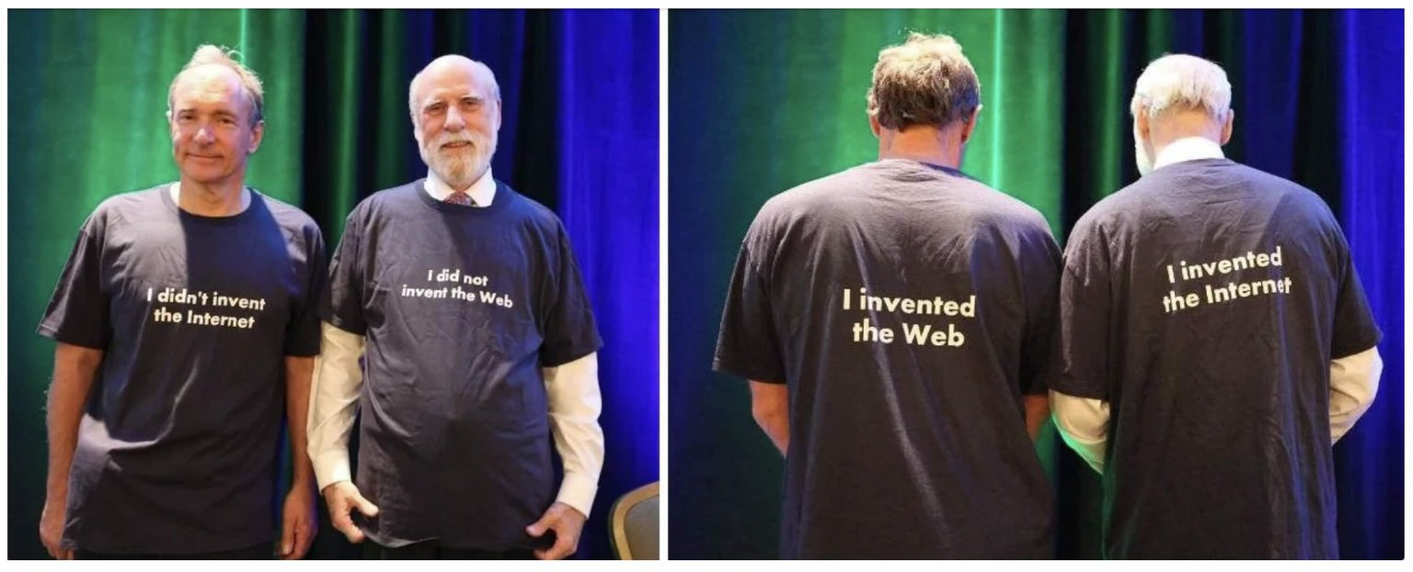
The Internet and the Web are two different things. The Internet is a foundational network of networks. The World Wide Web is one of many applications that run on the Internet.
The correct answer is False
Sir Tim Berners-Lee and Vint Cerf - fathers of the Web and the Internet, respectively - at the World Wide Web Consortium's 20th Anniversary

Slide 4
The Internet
The Internet is a network of networks.
Every device that is directly connected to the Internet requires a unique IP address.
Data travels in packets between these IP addresses. It is crucial that these IP addresses remain unique for the Internet to keep working.

Slide 5
The Core Principles Behind the Internet
The Internet is built on two core principles:
Open standards that ensure devices can communicate seamlessly across networks with different underlying technologies worldwide, to guarantee interoperability.
Registration of global Internet identifiers (names, numbers and ports), coordinated openly and without commercial control, to guarantee global uniqueness.
Together, they make the Internet a permissionless, global platform for innovation and communication.

Slide 6

A Short History (1980s to 1990s)
The US Department of Defence contracted administration of names, numbers and protocols to the University of Southern California’s ISI
Run by Jon Postel, the function was called Internet Assigned Numbers Authority (IANA)
The RIR system was formed in the early 1990s, starting with the RIPE NCC in 1992, APNIC in 1993 and ARIN in 1997
Internet number resource administration split from Domain Name System (DNS)
Jon Postel

Slide 7



Early Registrations
Early IP address space referred to as “legacy space”
Internet number resources allocated liberally
Organizations made simple request; no contract required
The Internet rapidly expanded, distribution could not be managed this way

Slide 8

RIR
Manages the allocation, administration and registration of Internet number resources in a specific region of the world.

Slide 9
This is why RIRs exist
Regional Internet Registries (RIRs) were set up to ensure the accurate registration of IP address allocations.
The goal is to ensure the uniqueness of IP addresses so that the Internet continues to function.

Slide 10
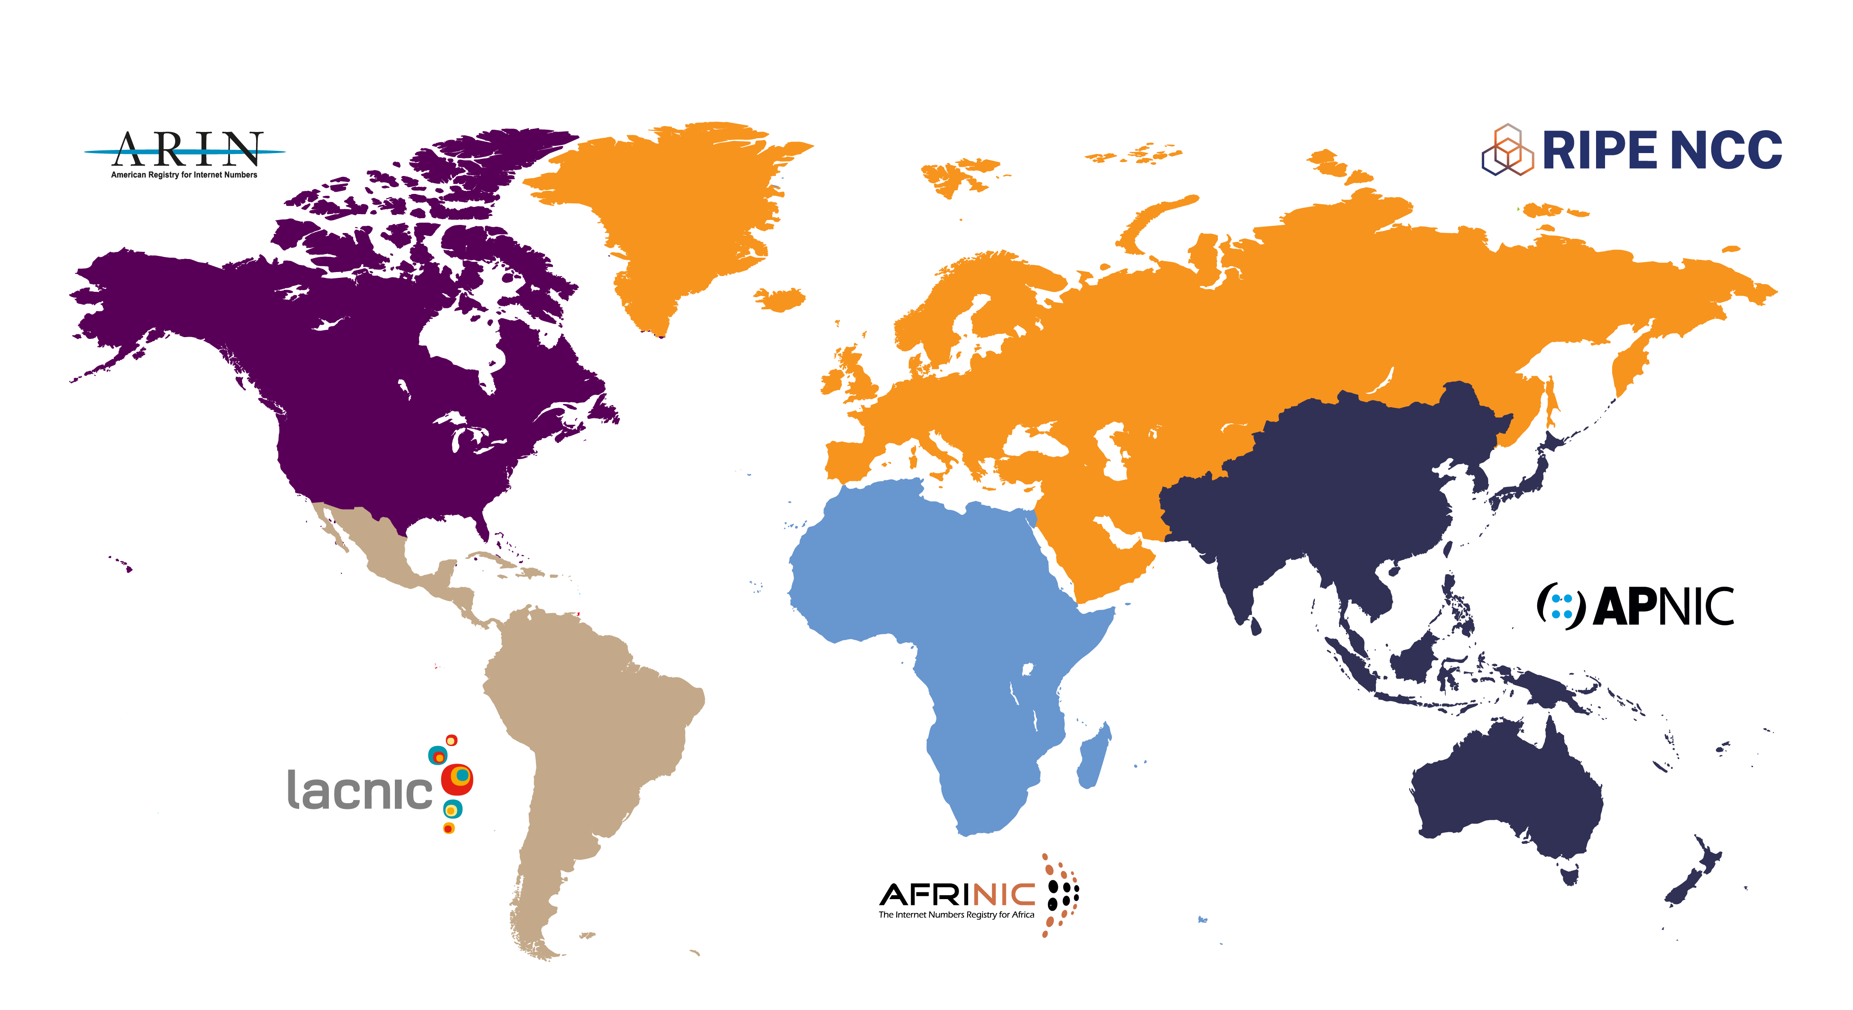
The Regional Internet Registries

Slide 11



Functions of an RIR
Manage and distribute Internet Number Resources:
IPv4 and IPv6 addresses
Autonomous System numbers (ASNs)
Maintain directory services including: Whois, Whowas, and routing registries
Provide reverse DNS
Support Internet infrastructure through:
Technical coordination
Community-driven policy process
Training and capacity building

Slide 12
Supporting the Internet
Scalability: By promoting the use of IPv6
Security: Providing RPKI to protect against route hijacks and misconfigurations
Policy Development: Takes place through bottom-up, multistakeholder processes
Capacity Building: Supporting network operators and communities through training and education

Slide 13
The RIRs are:
Independent: Not governmental bodies or entities
Membership-based: Open to Internet number resource holders in the regions (ISPs, NRENs, governments etc.)
Not-for-profit: Funded by membership fees
Community-driven: Policies are set by the community

Slide 14
RIR Governance
Each RIR community sets the policies by which that RIR registers and distributes resources
Each RIR is established under the legal framework of a specific country
Community
policy
National
legal
framework
RIR
Technical
remit
The five RIRs fulfil a specific function in the global Internet governance system

Slide 15
The NRO and the ASO

Slide 16

The Number Resource Organization
The Number Resource Organization (NRO) is the coordinating body for the five Regional Internet Registries (RIRs).
It serves as the Address Supporting Organization at ICANN.
Part of the Supporting Organizations (SO) since 1999.
Charged with reviewing and developing recommendations on Internet Protocol (IP) address policy and advises the ICANN Board on policy issues relating to the operation, assignment, and management of IP addresses.

Slide 17
NRO Mission
To actively contribute to an open, stable, and secure Internet by:
Providing and promoting a coordinated Internet number registry system
Being an authoritative voice on the multistakeholder model and bottom-up policy process in Internet governance
Coordinating and supporting joint activities of the RIRs

Slide 18

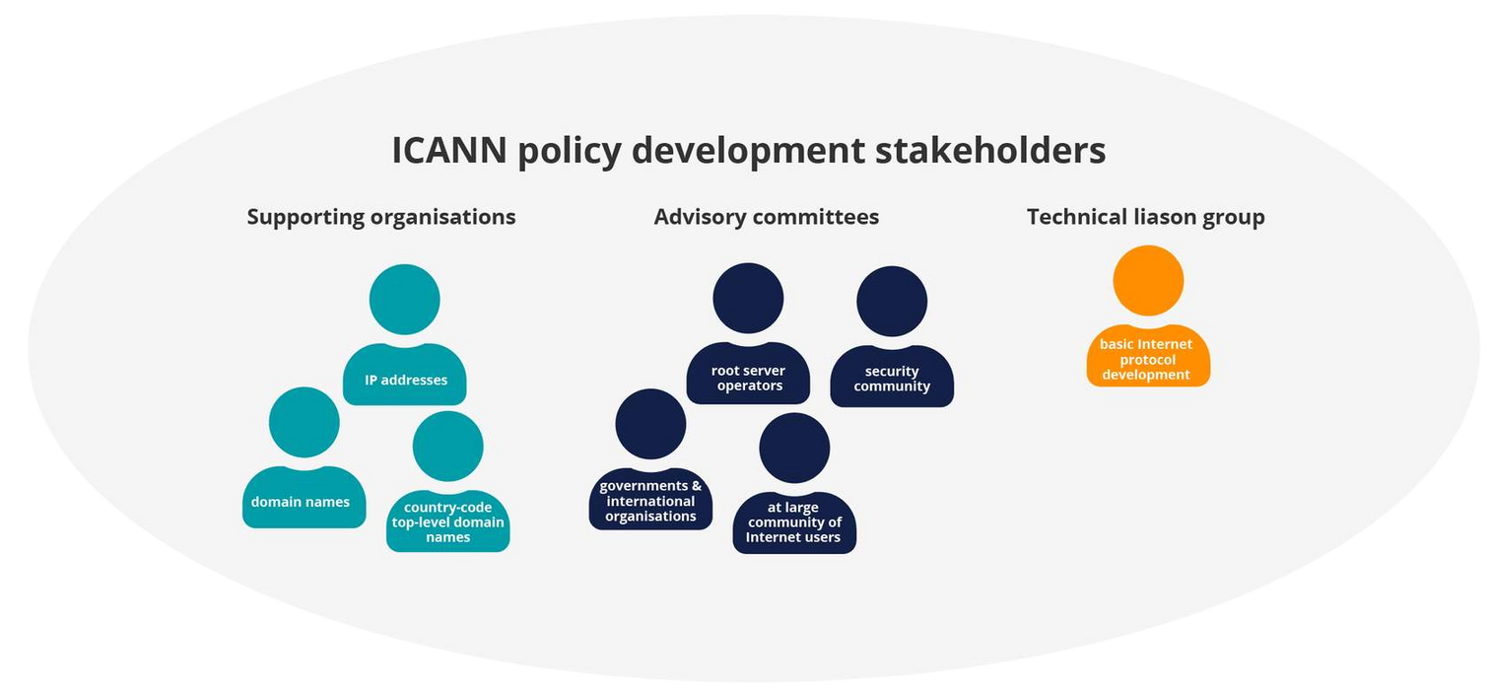


ICANN Policy Stakeholders
Supporting Organisations
ASO: Address Supporting Org.
GNSO: Generic Names Supporting Org.
CCNSO: Country Code Names Support Org.
Advisory Committees
At Large Advisory Committee
DNS Root Server System Advisory Committee
Governmental Advisory Committee
Security and Stability Advisory Committee
Technical Liaison Group
Works with the organisations developing the basic Internet protocols.
https://www.icann.org/community

Slide 19
ICANN ASO AC (Address Council)
Who is it: | NRO Number Council
What is it? | Number Resource Advisory Council
How is it Organized? | 15 Members [3 From Each Region] – 2 Elected at Large – 1 Appointed by RIR Board • RIR & ICANN Observers
Term of Office | Different for every RIR
What Does it Do? | Advise ICANN Board on Internet Numbers • Overseeing the Global Policy Development Process • Appoint ICANN Board Members (2) • Appoint member to ICANN NomCom (1)

Slide 20
Policy Development

Slide 21
True or False?
You can participate in policy development in a Regional Internet Registry.

Slide 22
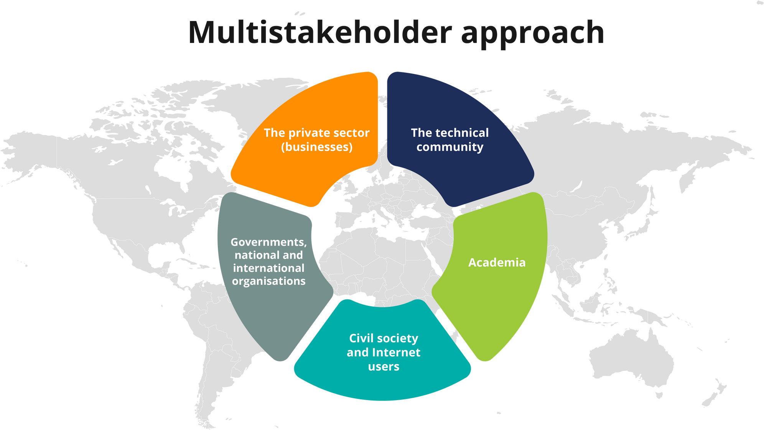
Multistakeholder Approach

Slide 23



Policy Development Process
NEED
Inclusive
Anyone can participate
DISCUSS
EVALUATE
Bottom Up
The Internet community
proposes and approves
policies
Transparent
IMPLEMENT
CONSENSUS
Policies and decisions are documented and publicly available

Slide 24
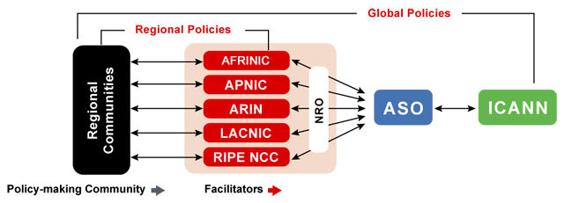
The Global Policy Development Process

Slide 25
Internet Number Resources IPv4, IPv6, and Autonomous System Numbers (ASNs)

Slide 26
True or False?
There are more IPv6 addresses than grains of sand on the Earth.

Slide 27

The correct answer is True
Unique IPv4 Addresses
4,294,967,296 or roughly 4.2 billion unique addresses
Unique IPv6 Addresses
340,282,366,920,938,463,463,374,607,431,768,211,456
or 340 undecillion unique addresses.
Or more IPv6 addresses than grains of sand on the Earth...

Slide 28
Internet Protocol (IP) Addresses
IP address – unique numerical address assigned to every device connected to a TCP/IP network that facilitates moving data across the network
IPv4
32-bit addresses; written in dotted decimal
2^32= ~4.2 billion
e.g. 205.150.58.7
IPv6
128-bit addresses; written in hexadecimal
2^128= ~50 octillion for each of the roughly 6.5 billion people alive
e.g. 2001:0503:0C27:0000:0000:0000:0000:0000

Slide 29


IP Addresses are Not Domain Names
IP address
DNS name
[Identifier]
[Reference]
e.g. 2001:0db8:85a3:0000:0000:8a2e:0370:7334
e.g. www.nro.net
e.g. 2001:0db8:85a3:0000:0000:8a2e:0370:7334
Computers recognize numbers
Identifies a device on the Internet
Used for routing (moves information across an inter-network from a source to a destination)
Every device directly connected to the Internet requires a unique IP address
People recognize names
Maps host name to unique IP address
A means of storing and retrieving information about hostnames and IP addresses in a distributed database

Slide 30
Autonomous System Numbers (ASNs)
Globally unique numbers used to exchange routing information with neighboring autonomous systems
Group of IP networks administered under the umbrella of a single entity
Network operators must have an ASN to control routing within their network and to exchange routing information with other Internet Service Providers

Slide 31
How IP Addresses are Issued
IANA
(Internet Assigned Numbers Authority)
Manage GLOBAL unallocated IP address pool
Allocate
RIRs
(AFRINIC, APNIC, ARIN, LACNIC, RIPE NCC)
Manage REGIONAL unallocated IP address pool
Allocate
ISP (Customers)
Allocate
ISP
End User
End User (Customers)
Reassign

Slide 32
Routing How Data Moves

Slide 33
Core Internet Functions: DNS & Routing
The Internet relies on two critical systems:
DNS - translates domain names to IP addresses (forward lookup) and IP addresses to domain names (reverse lookup)
Routing – forwards IP data packets across the network from source to destination
These critical systems are not inherently secure
Subject to misconfigurations and nefarious activity
Traditional options for verifying routing
Internet Routing Registry (IRR)
Letters of Authority (LOAs)
Seems ”legit” (informal arrangement between ISPs)

Slide 34





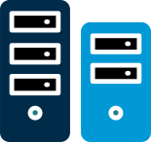
The Internet is…
The Internet

Slide 35






A Network of Networks
Internet
backbone
mobile network
satellite/wireless network
copper/fibre network

Slide 36

Networks That Use Standard Protocols
Autonomous System Number (ASN)
AS17726
AS11167
202.150.8.99
12.100.1.8
2401:A700:1::D1
AS24478
202.150.8.132
202.178.120.15
2401:A700:F::E3
2401:3E00:EE::15A
IP Address (IPv4)
202.178.112.1
IP Address (IPv6)
2401:3E00:DD::1

Slide 37
Noteworthy Developments

Slide 38
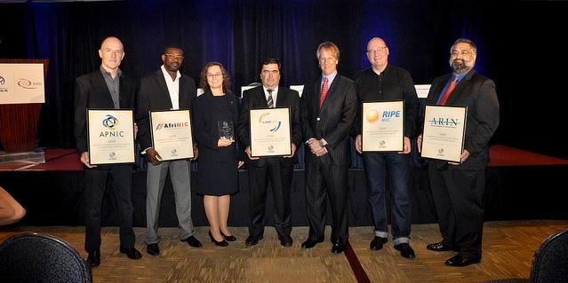
Global IPv4 Depletion at IANA
Each RIR received its last /8 IPv4 address block from IANA on 3 February 2011

Slide 39
Available IPv4 Space in each RIR In terms of /8s

Slide 40
IPv6 Deployment
As per ISOC, the rate of IPv6 deployment is at 50% worldwide Source: https://pulse.internetsociety.org/en/technologies/
Google IPv6 statistics show ~47% of global Internet traffic is over IPv6
Source: https://www.google.com/intl/en/ipv6/statistics.html
As of October 2025

Slide 41
Percentage of Members with IPv6 in each RIR
75.50%
97.25%
48.20%
69.12%
56.91%

Slide 42
Post-IPv4 Depletion
Movement to IPv6 has been steady
ISPs rolling out IPv6
Steady increase in IPv6 traffic
Increase in IPv6 requests
There is still a demand for IPv4
All RIRs are still receiving significant number of IPv4 requests
Customers increasingly turning to the secondary IPv4 transfer market for address space
Increase in fraudulent requests for IPv4 space
Submitting falsified business records, personal ID documents, etc.

Slide 43
IPv4 Transfers
Developed due to on-going demand for rapidly depleting IPv4 addresses. Choices were:
Facilitate IPv4 market transfers through RIR policies
Watch a black market emerge with no registry interaction
Needs-based IPv4 market transfer policies developed by communities
Allowed IPv4 holders to transfer space to qualified recipients
RIR’s role
Ensure compliance with needs-based policies
Maintain the accuracy of the registry
RIRs are not privy to any financial data regarding transactions between parties

Slide 44
Inter-RIR IPv4 Transfers
Number of transfers
Number addresses transferred
Recipient RIR
 | AFRINIC | APNIC | ARIN | LACNIC | RIPE NCC
AFRINIC |  | 0 | 0 | 0 | 0
APNIC | 0
ARIN | 0
LACNIC | 0
RIPE NCC | 0
248
19
665
Source RIR
2.379M
.02202M
3.984M
418
32
758
20.460M
.17831M
34.751M
6
33
45
.01170M
7.1890M
.1025M
157
323
18
2.7299M
9.3379M
.01535M

Slide 45
RIR Service and Tools

Slide 46



Whois
Public directory service Used to query databases that store registered users of an Internet resource
Differs in usage or content depending on the type of registry
Number resource registries
Domain name registries and registrars
Routing registries
RIR’s Whois registry is publicly accessible

Slide 47
RIR Whois Information
Publicly displayed registration data including:
IP number resources issued by RIRs or predecessor registry (“legacy” space)
Organizations and their contact info (mailing addresses, emails, phone numbers)
Original registration date and last updated date
Customer reassignment information (ISP customers)
Referential information to authoritative RIRs

Slide 48
Routing Security Tools
The RIRs have deployed two technologies to help secure Internet routing:
Resource Public Key Infrastructure (RPKI)
Security framework designed to improve/secure the Internet’s routing infrastructure
Verifies association between resource holders and their number resources
Validated Internet Routing Registry (IRR)
Validation mechanisms added to IRR that guarantee routing announcements are published only by an authorized network
A third technology – ASPA (AS Provider Authorisations) is in development

Slide 49
Resource Public Key Infrastructure (RPKI)
Public key infrastructure framework designed to secure the Internet’s BGP routing infrastructure
Cryptographically certifies network resources (AS Numbers & IP address prefixes) and route announcements
Route Origin Authorizations (ROAs) define which AS is authorized to originate a prefix
Provides stronger validation than existing technologies such as:
Internet Routing Registries (IRR)
Letters of Authority (LOA)
Five RIRs (NRO) collaborating on this cross-RIR project

Slide 50



Why is RPKI important?
Establishes a level of trust that the RPKI information is authentic and is confirmed coming from the authorized holder of the resources
The RPKI gives network operators a method to make better judgments
on which is the valid source (origin) of a route
announcement
RPKI can limit the impact of a configuration mistake or nefarious activity of a bad actor

Slide 51
RPKI Adoption Rate in Each Region
% of IP address space covered by RPKI certificates as of 27 October 2025
REGION | IPv4 ADOPTION | IPv6 ADOPTION
AFRINIC | 31.15 | 11.06
APNIC | 37.94 | 18.09
ARIN | 40.91 | 63.71
LACNIC | 56.93 | 57.74
RIPE NCC | 74.35 | 41.64
https://ftp.ripe.net/pub/stats/ripencc/nro-adoption/latest/rir-adoption.txt

Slide 52
NRO RPKI Program: Securing the Internet routing system, together
Purpose: “To provide a more consistent and uniformly secure, resilient and reliable RPKI service”
Why is it important?
It creates a space for structured coordination and collaboration on RPKI among the RIRs
Current diversity/inconsistency among RIRs’ RPKI implementations
Some RPKI challenges/concerns need to be addressed by the five RIRs in alignment
Notes:
Although there is probably multiple areas that would benefit from better coordination and collaboration among the five RIRs in the RPKI space, there are a couple of challenges that we are aware of that make the RPKI Program particularly important. We know that there is some diversity and inconsistency in the way the five RPKI systems have been implemented, and the features and related services offered and how they are made available. This is pictured for example by the annex in the MANRS document on requirements and standards for operators of RPKI services, where it’s shown that not all the RIRs comply with all those requirements and standards. (The table is out of date. The SG we will be providing MANRS with an updated version)
We know that there is some diversity and inconsistency in the way the five RPKI systems have been implemented, and the features and related services offered and how they are made available.

Slide 53
RPKI NRO Program Objectives
Progress towards improved transparency, robustness, and security of the RPKI system
Building on 2024 work:
Key aspects of robustness documented
TA configuration problem statement and potential solutions
Increased consistency of the RPKI system user experience
Building on 2024 work:
Documentation of baseline for RPKI services/features offered by each RIR
User research with users interacting with multiple RIRs
The technical community is kept informed and engaged throughout the program.
RPKI Program updates presented at relevant events
Blog articles in RIR blogs
Etc.

Slide 54
NRO Publications
Global Internet Number Statistics
Internet Number Resources Status Report (updated quarterly)
Global stats on IPv4, IPv6, ASN (updated daily)
RPKI Adoption Reports by IPv4, IPv6, economy (updated daily)
https://www.nro.net/statistics
Comparative Policy Overview
Updated quarterly
Information on RIRs Membership policies (access to delegation and registration services)
https://www.nro.net/rir-comparative-policy-overview

Slide 55
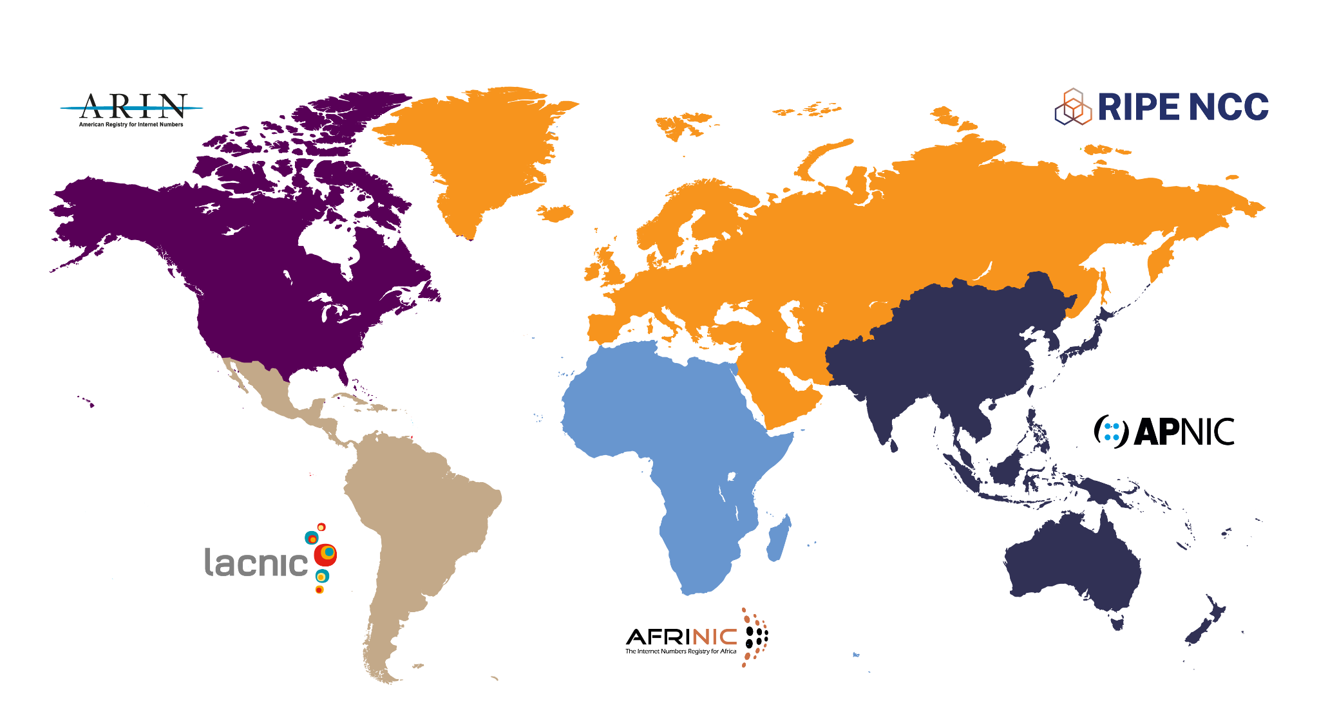
Stay Informed
arin.net
ripe.net
apnic.net
lacnic.net
afrinic.net

Slide 56
Any Questions?

Slide 57
Thank You
secretariat@nro.net

