Slide 1
ICANN 84 | Joint Meeting ICANN Board & AS0 Second Consultation on Updating ICP-2
29 October 2025

Slide 2

2025 NRO NC (ASO AC) Members
*Appointed by RIR Board
AFRINIC call for nominations to the NRO NC https://afrinic.net/call-for-volunteers-on-the-nro-number-council-nro-nc-address-council-aso-ac

Slide 3
Why revisit ICP-2?
1992 | RIPE NCC established
1993 | APNIC established
1997 | ARIN established
1998 | ICANN established
2001 | ICANN adopted ICP-2
2002 | LACNIC established
2005 | AfriNIC established
ICP-2 is nearly 25 years old
The Internet has changed over the last quarter century
The relationships between RIRs and ICANN and between each other have changed
Need to more explicitly provide for:
An RIR’s ongoing responsibilities
Potential derecognition of an RIR that can no longer adequately provide for the needs of its numbering community

Slide 4
ICP-2 Review Timeline (Principles Document and Consultation)
8 Oct 2024 | ASO AC published a proposed set of 24 “core principles” to be included in the next version of ICP-2 (“Principles Document”)
8 Oct – 6 Dec 2024 | Public consultation on the ICP-2 Principles Doc
Dec 2024 – Feb 2025 | ASO AC reviewed community feedback on ICP-2 Principles Document received during public consultation
24 Feb 2025 | ASO AC published ICP-2 Questionnaire Summary Report (‘ICP-2 Principles Consultation Report’)
14 April 2025 | ASO AC published draft ‘RIR Governance Document’ and launched community consultations
28 August 2025 | ASO AC published revised draft ‘RIR Governance Document’ and launched community consultations

Slide 5
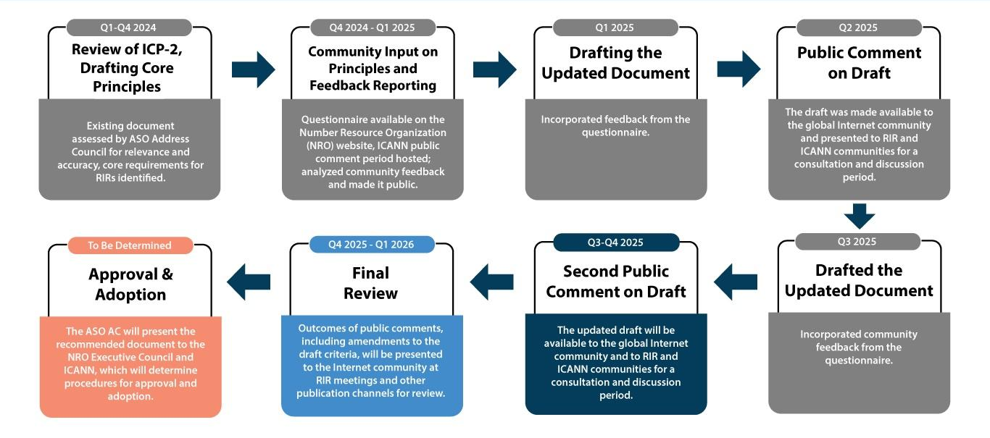
ICP-2 Review Timeline

Slide 6
Version 2: Key Changes
Title: Small change to the title of the document
Preamble: Expanded, explaining the goals of the document
Implementation Procedures: Reference to separate “Implement Procedures” document that may provide further implementation details on any obligation
Recognition/Derecognition: Additional protections in Recognition and Derecognition procedures for affected RIRs, including the possibility for a candidate RIR to be recognized on less than the unanimous approval of the existing RIRs
Audits/Proposals: New criteria for RIR members or ICANN to request ad hoc audits or propose derecognition
Emergency Continuity: New ‘Emergency Continuity’ procedure to temporarily transfer an RIR’s responsibilities to an ‘Emergency Operator’

Slide 7
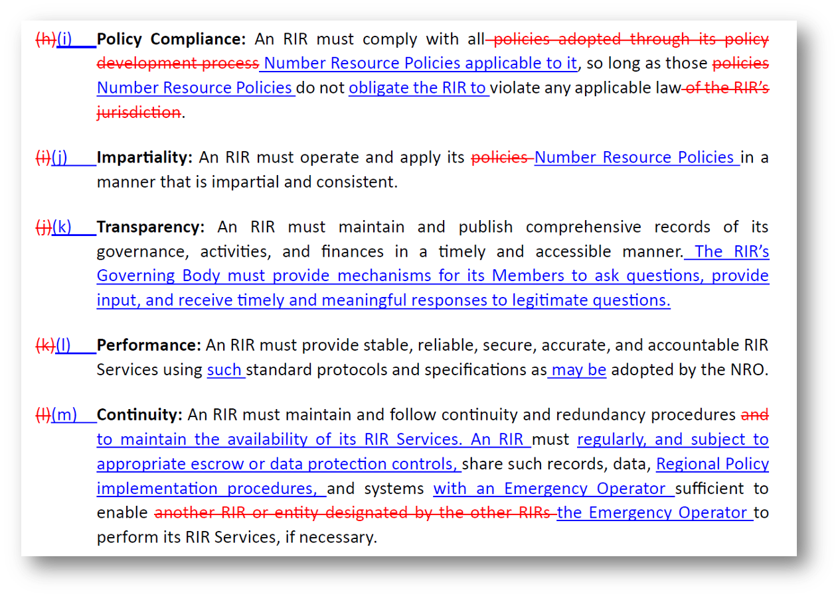
Resource: Redline of Changes
https://www.nro.net/wp-content/uploads/RIR-Governance-Document-v2-deltas.pdf

Slide 8
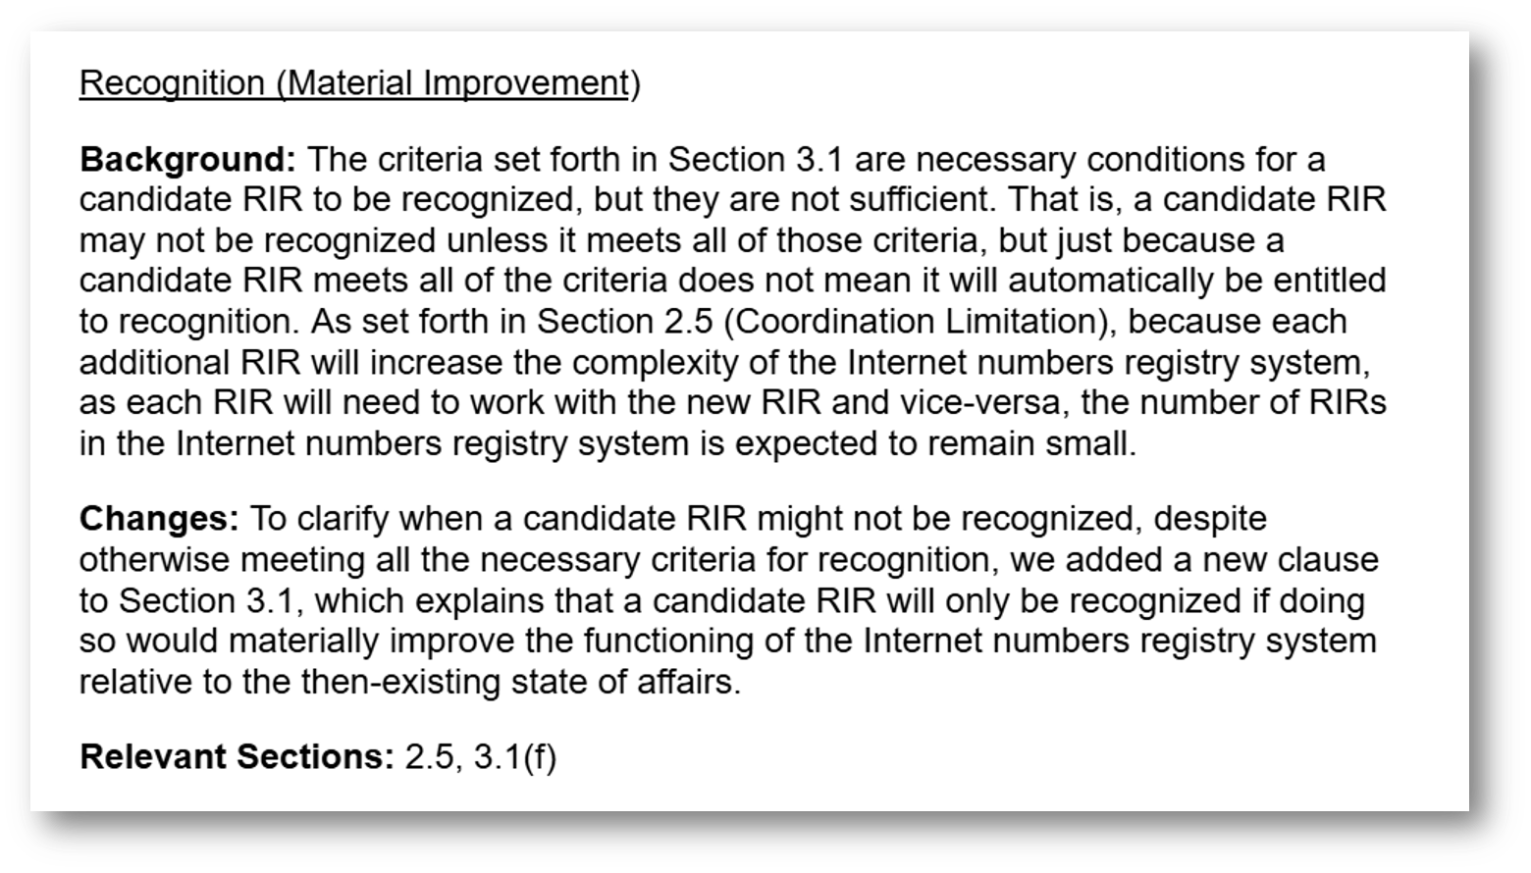
Resource: Rationale Behind the Changes
https://www.nro.net/policy/internet-coordination-policy-2/rir-governance-document-version-2-summary-of-differences-and-rationale-for-changes/

Slide 9
Title, Preamble, Roles,
and Implementation Procedures

Slide 10
Title
Previously: ‘Governance Document for the Recognition, Maintenance, and Derecognition of Regional Internet Registries’
Now: ‘Governance Document for the Recognition, Operation, and Derecognition of Regional Internet Registries
Rationale
‘Operation’ better describes the nature of the operational requirements in the document

Slide 11
Preamble
Change
Longer preamble that clearly defines the document’s purpose and goals
Rationale
Provides more context for the document and explains how its provisions are intended to advance certain goals

Slide 12
Implementation Procedures
Change
New Section 1.3 notes that the the RIRs and ICANN may jointly develop specific additional procedures to implement the RIR Governance Document (‘Implementation Procedures’)
Rationale
Address the community concern that additional details or procedures will need to be developed around certain general obligations in the RIR Governance Document
Note
The Implementation Procedures cannot contradict or override any terms of the RIR Governance Document

Slide 13
Recognition and Derecognition

Slide 14
Recognition
Change
A candidate RIR may be recognized on less than unanimous support by the existing RIRs if an independent third party appointed by ICANN determines that a single RIR has made a material error of fact or provided an inadequate justification for its recommendation not to recognize the candidate RIR
Rationale
There was concern that an RIR could object to recognizing a new RIR for inadequate or illegitimate reasons
We provided a mechanism to overrule a dissenting RIR while protecting the need for RIRs to ensure that they are not forced into business relationships with new entities that may not be lawful in their jurisdictions

Slide 15
Derecognition Proposal (1)
Change
Provided additional protections for an affected RIR in the derecognition process:
Proposal: Strengthened criteria for derecognition proposal - rationale and details required
Response: Opportunity for affected RIR to publicly respond in writing
Transparency: ICANN must publish the reasons for its decision
Rationale
It is important to ensure that the derecognition process is transparent, faithful to the requirements of the RIR Governance Document, and protective of the rights of the affected RIR

Slide 16
Derecognition Proposal (2)
Changes
New threshold of 2,000 members or 25% of the members of an RIR, whichever is lower, to initiate the derecognition process
Also allows for ICANN to initiate the derecognition process (but derecognition still requires RIR approval)
Rationale
Different RIRs will have different numbers of members and different criteria for becoming a member
Allowing ICANN to initiate derecognition provides additional neutrality

Slide 17
Audits

Slide 18
Regular Audits
Previously: General requirement for RIRs must undergo periodic audits
Now: Frequency is specified: each RIR must be audited at least once every three years
Rationale
Provide more specificity around frequency of periodic audits
Ensure that problems are identified early on

Slide 19
Ad Hoc Audits
Change
An ad hoc audit of an RIR can be requested by:
The other RIRs by majority decision (previously required unanimity)
2,000 members or 25% of the members of the RIR, whichever is lower (new)
ICANN (new)
Rationale
Provide additional mechanisms to catch problems early on

Slide 20
Emergency Continuity (New)

Slide 21
Emergency Continuity
New
Mechanism to quickly and temporarily transfer an RIR’s responsibilities to an ‘Emergency Operator’ in urgent situations
Requires unanimous agreement of other RIRs and ICANN
Must be time-limited, publicly justified, and followed by a community consultation
Rationale
Need to ensure continuity of service in emergency situations that don’t involve derecognition or situations in which derecognition is being pursued but may take a long time

Slide 22
Emergency Continuity Protections
New
Rationale: ICANN must publish rationale and scope of Emergency Continuity and initiate community engagement process as soon as possible
Limitation: Emergency Continuity cannot exceed 90 days (unless formally renewed)
Postmortem: RIRs and ICANN must conduct post-event review, publish report, and provide community feedback process
Rationale
Ensure that Emergency Continuity process is accountable and does not become a substitute for derecognition
Ensure lessons from Emergency Continuity are documented and RIR and ICANN communities remain engaged

Slide 23
Miscellaneous

Slide 24
Rectification
Changes
Each amendment to the RIR Governance Document must specify a grace period to become compliant
Three-year grace period to become compliant with any obligations that were not already contained in ICP-2 after adoption of the RIR Governance Document
Rationale
Ensure clarity by requiring grace periods to be clearly specified in any amendment
Provide current RIRs with the time necessary to align their processes with the RIR Governance Document

Slide 25
New Section on Dispute Resolution
4.1(q) Dispute Resolution
Require each RIR to provide a fair and effective adjudicative mechanism for members to enforce their rights against the RIR

Slide 26
New Section on Good Faith
2.8 Good Faith
Explicitly states that ICANN and all RIRs will act in good faith and with fair dealing under the RIR Governance Document
Requires all actions to be undertaken promptly and within reasonable timeframes

Slide 27
RIR Governance Document: ICANN’S Role
Powers / Limitations
CAN initiate a proposal to derecognize an RIR
CAN initiate an ad hoc audit of an RIR
CANNOT unilaterally recognize or derecognize an RIR or initiate emergency continuity procedures
Responsibilities
Conduct an independent review if the RIRs do not unanimously recommend recognizing a Candidate RIR
Perform regular and ad hoc audits of RIRs
Participate in the Emergency Continuity process

Slide 28
ICANN Public Comment
Feedback on this Consultation must be submitted by 7 November 2025.
https://www.icann.org/en/public-comment/proceeding/second-draft-of-the-rir-governance-document-28-08-2025
Please share constructive feedback that is specific to this document.
We are particularly interested in hearing your views on whether this draft addresses questions and concerns with the previous draft.
This document does not address the implementation of the RIR governance framework; comments on implementation will be considered out of scope.

Slide 29

Revised ‘Governance Document for the Recognition, Operation, and Derecognition of Regional Internet Registries’ (RIR Governance Document)
https://www.nro.net/icp-2-rir-governance-document-v2
Notes:
Note, the title of the document has changed

Slide 30
Supporting Documents
Redline of changes: https://www.nro.net/wp-content/uploads/RIR-Governance-Document-v2-deltas.pdf
Summary of changes and rationale: https://www.nro.net/policy/internet-coordination-policy-2/rir-governance-document-version-2-summary-of-differences-and-rationale-for-changes/
RIR Preliminary Assessment: https://www.nro.net/preliminary-assessment-document-published/
FAQ: https://www.nro.net/policy/internet-coordination-policy-2/faq/

Slide 31
Thank You

Slide 32
Questions?

